Slide 1
Decarbonizing Steel
13 March 2024
Mimi Khawsam-ang, Max de Boer, Grace Frascati & Gernot Wagner

Slide 2
Steel sector overview: The problem

Slide 3
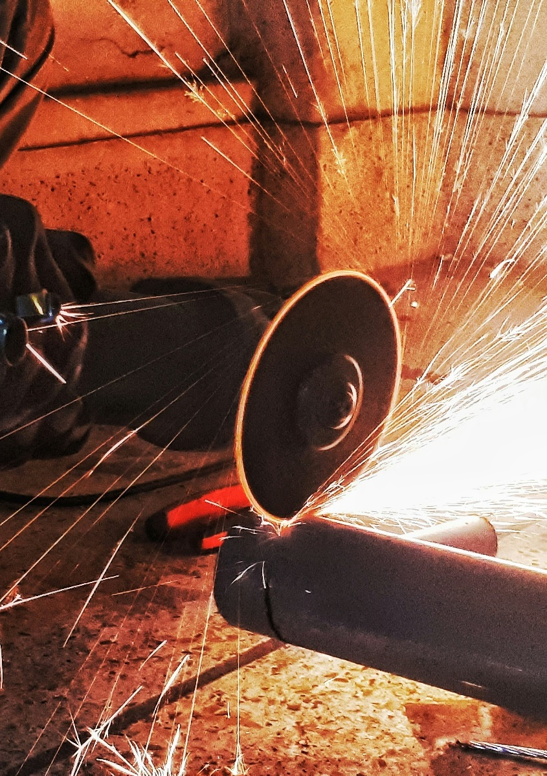
Key messages Steel sector overview
The global steel sector is responsible for approximately 10% of global CO₂e emissions
Global steel emissions have more than doubled since 2000 (from 1.2 gigatonnes in 2000 to 2.5 gigatonnes in 2021). However, emissions have started to decouple from production levels since 2016
Without intervention, emissions are expected to continue growing due to rising demand from emerging economies. Reaching net zero by 2050 would require a 25% emission reduction by 2030
Steel is currently produced through three main production routes, all of which emit CO₂:
Blast furnace-basic oxygen furnace (BF-BOF): 72% of global steel production. It uses coke and limestone to produce pure iron from iron ore in a blast furnace, which is then turned into steel in an oxygen furnace
Scrap electric arc furnace (scrap EAF): 21% of global steel production. Scrap metal is melted in an EAF using electrical energy
Natural gas-based direct reduced iron-electric arc furnace (NG DRI-EAF): 7% of global steel production. Iron ore is turned into iron using natural gas, which is then melted in an EAF to produce steel
On average, BF-BOF is the cheapest production method ($390 per tonne vs. $415 for scrap EAF and $455 for NG DRI-EAF). However, regional variations in costs (such as for raw material and fuel) make all three methods competitive
Downstream activities after crude steelmaking (e.g., refining, casting, rolling) represent less than 20% of the total steel production emissions
Because steel is a 100% recyclable material, increased use of scrap metal can help decarbonize the steel sector
Credit: Mimi Khawsam-ang, Max de Boer, Grace Frascati, and Gernot Wagner (22 February 2024); share/adapt with attribution. Contact: gwagner@columbia.edu

Slide 4
Steel sector scope 1 and 2 emissions are ~10% of global emissions
CO₂e emissions in 2021: 50.1 billion tonnes
Scope 1
Scope 2
29%
29%
20%
15%
7%
100%
Non-metallic minerals 2%
Non-ferrous metals 2%
Oil 4%
Agricultural fuel combustion 4%
Other 2%
Rail 1%
Refining 4%
Aviation 9%
Commercial
combustion
21%
Commercial combustion 7%
Natural gas
22%
Land use, land-use change, and
forestry 14%
80%
Chemicals
13%
Marine 11%
Waste
21%
HFCs from
refrigeration
and A/C
25%
Iron and steel
16%
60%
Cement
17%
Crops
28%
40%
Coal
74%
Road
77%
Residential
combustion
54%
Oil and gas
20%
20%
Livestock
33%
Remaining industries
19%
Iron and steel
17%
0%
Industry
Power and heat
Agriculture, land use, and waste
Transport
Buildings
Sources: Scope 1 emissions from Rhodium Group ClimateDeck (September 2023); Scope 2 iron and steel estimate from IEA (2023). Credit: Mimi Khawsam-ang, Max de Boer, Grace Frascati, and Gernot Wagner (22 February 2024); share/adapt with attribution. Contact: gwagner@columbia.edu

Slide 5
Global steel emissions have more than doubled since 2000, with emission growth decoupled from production growth after 2016
Global CO₂e emissions decoupled from steel production post-2016
Observations
In recent years, the steel industry has made efforts to reduce its carbon footprint with more energy-efficient processes and technologies
Though not enough by itself, recycling rates have improved (sitting around 80%-90% globally)
Better manufacturing yields have made supply chains more efficient
Enhanced control processes and predictive maintenance strategies have led improvements in operational efficiency
China, the largest steel producer in the world, saw a 3% decline in steel output in 2021 and a similar decline in the years since
Global CO₂e emissions from iron and steel production (in gigatonnes)
Global steel production (in million tonnes)
4
2,000
Steel production
Iron and steel production emissions
3
1,500
2
1,000
1
500
0
0
’00
‘01
’02
‘03
‘04
‘05
‘06
’07
‘08
‘09
‘10
‘11
‘12
‘13
‘14
‘15
‘16
‘17
‘18
‘19
‘20
‘21
Note: The majority of the world’s iron is used to make steel. Sources: Rhodium Group ClimateDeck (September 2023); World Steel Association; McKinsey, Decarbonization Challenge for Steel; IEA, CO₂ Emissions in 2022, Reuters, China 2021 Crude Steel Output. Credit: Mimi Khawsam-ang, Max de Boer, Grace Frascati, and Gernot Wagner (22 February 2024); share/adapt with attribution. Contact: gwagner@columbia.edu

Slide 6
Crude steel is now produced through three main methods that all emit CO₂:
1
Blast furnace-basic oxygen furnace (BF-BOF), which alone produces ~80% of iron & steel CO₂
Scrap electric arc furnace (EAF), limited to recycled scrap
Natural gas-based direct reduced iron-electric arc furnace (NG DRI-EAF) most expensive, least used
2
3

Slide 7
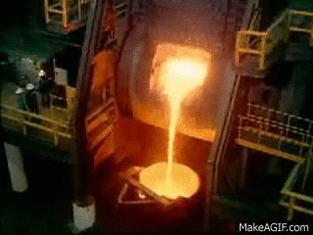
Of three main steelmaking methods, blast furnace-basic oxygen furnace (BF-BOF) is the cheapest, most popular, and most polluting
1
BF-BOF ~73% of global steel production and ~80% of iron and steel CO₂ emissions
Observations
BF-BOF: Iron ore, coke, and limestone produce iron in a blast furnace, which is turned into steel in an oxygen furnace
Iron ore
Iron
Steel
2.33 tonnes of CO₂ per tonne of steel
FeO₂ + coal = Fe + CO₂
Sources: World Steel Association; IEEFA (2022); IEA, Iron and Steel Technology Roadmap (2020); Steel Technology, Basic Oxygen Furnace Steelmaking; Recycling Today, Growth of EAF Steelmaking; Wildsight, Do We Really Need Coal to Make Steel. Credit: Mimi Khawsam-ang, Max de Boer, Grace Frascati, and Gernot Wagner (22 February 2024); share/adapt with attribution. Contact: gwagner@columbia.edu

Slide 8
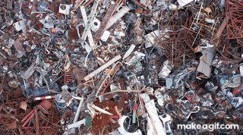
Of the three main steelmaking methods, scrap electric arc furnace (EAF) is the cleanest, though limited by the scarcity of scrap material
2
More than 80% of steel recycled; scrap EAF accounts for ~22% of global steel production
Observations
BF-BOF: Iron ore, coke, and limestone produce iron in a blast furnace, which is turned into steel in an oxygen furnace
Scrap EAF: Scrap metal is melted in an EAF using electrical energy
Iron ore
Iron
Steel
Produces 0.66 tonnes of CO₂ per tonne of crude steel, 72% less than BF-BOF
Takes collected scrap steel as input into an EAF
Sources: World Steel Association; IEEFA (2022); IEA, Iron and Steel Technology Roadmap (2020); Steel Technology, Basic Oxygen Furnace Steelmaking; Recycling Today, Growth of EAF Steelmaking; Wildsight, Do We Really Need Coal to Make Steel. Credit: Mimi Khawsam-ang, Max de Boer, Grace Frascati, and Gernot Wagner (22 February 2024); share/adapt with attribution. Contact: gwagner@columbia.edu

Slide 9
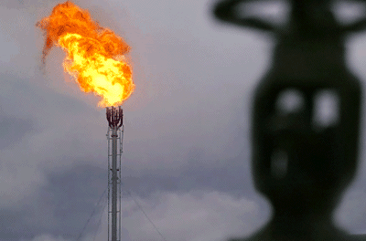
Of the three main steelmaking methods, natural gas-based direct reduced iron-electric arc furnace (NG DRI-EAF) is the most expensive and least used
3
BF-BOF ~73% of global steel production and 80% of iron and steel CO₂ emissions
Observations
BF-BOF: Iron ore, coke, and limestone produce iron in a blast furnace, which is turned into steel in an oxygen furnace
Scrap EAF: Scrap metal is melted in an EAF using electrical energy
NG DRI-EAF: Iron ore turns into iron using natural gas, which is then melted in an EAF to produce steel
Iron ore
Iron
Steel
Produces 1.39 tonnes of CO₂ per tonne of crude steel, 40% less than BF-BOF
Uses natural gas, a cleaner reduction agent than coal
Sources: World Steel Association; IEEFA (2022); IEA, Iron and Steel Technology Roadmap (2020); Steel Technology, Basic Oxygen Furnace Steelmaking; Recycling Today, Growth of EAF Steelmaking; Wildsight, Do We Really Need Coal to Make Steel. Credit: Mimi Khawsam-ang, Max de Boer, Grace Frascati, and Gernot Wagner (22 February 2024); share/adapt with attribution. Contact: gwagner@columbia.edu

Slide 10
At present, crude steel is produced through three main methods that all emit CO₂: BF-BOF, scrap EAF, and NG DRI-EAF
1
2
3
 | Blast Furnace-Basic Oxygen Furnace (BF-BOF) | Scrap Electric Arc Furnace (Scrap EAF) | Natural Gas-Based Direct Reduced Iron – Electric Arc Furnace (NG DRI-EAF)
Description | Iron ore, coke, and limestone produce pure iron in a blast furnace, which is turned into steel in an oxygen furnace | Scrap metal is melted in an EAF using electrical energy | Iron ore is turned into iron using natural gas, which is then melted in an EAF to produce steel
Main inputs | Iron ore, cooking coal | Scrap steel, electricity | Iron ore, natural gas
% of global steel production | 72% | 21% | 7%
CO2 per tonne of crude steel | 2.3 tonnes | 0.7 tonnes | 1.4 tonnes
Energy intensity per ton of crude steel | ~24 GJ | ~10 GJ | ~22 GJ
Average cost per tonne of crude steel | ~$390 | ~$415 | ~$455
Sources: World Steel Association; IEEFA (2022); IEA, Iron and Steel Technology Roadmap (2020); Steel Technology, Basic Oxygen Furnace Steelmaking; Recycling Today, Growth of EAF Steelmaking; Wildsight, Do We Really Need Coal to Make Steel. Credit: Mimi Khawsam-ang, Max de Boer, Grace Frascati, and Gernot Wagner (22 February 2024); share/adapt with attribution. Contact: gwagner@columbia.edu

Slide 11
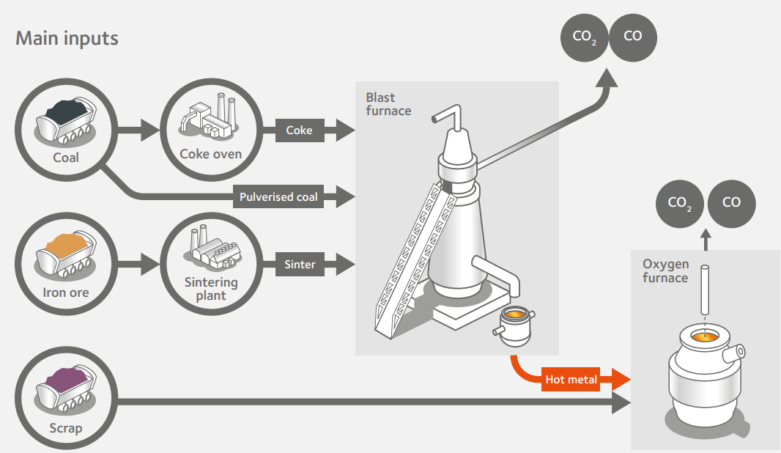
BF-BOF is the cheapest, most popular, and most polluting process which relies heavily on coal
Blast Furnace-Basic Oxygen Furnace (BF-BOF)
Process description
In the first step, coking coal and limestone is mixed with iron ore in a Blast Furnace (BF) to perform iron reduction and obtain molten crude iron
Crude iron is sent to Basic Oxygen Furnace (BOF) to be converted into cast iron
At this stage, up to 30% scrap steel can be added
Observations
BF-BOF accounts for 72% of global steel production
China, the world’s #1 steel producer, accounts for >50% world output and uses BF-BOF for 90% of steel production
Both steps in the BF-BOF process produce CO2 as a byproduct. On average, BF-BOF emits 2.3 tonnes of CO2 per ton of crude steel – the highest amount of the three conventional steel routes
BF-BOF remains cheapest means of steelmaking, with average production cost of $390/tonne
Source: AcelorMittal
Source: MIDREX (2021), ArcelorMittal (2021), World Steel Association (2021), IEEFA (2022), IEA Iron and Steel Technology Roadmap (2020). Credit: Mimi Khawsam-ang, Max de Boer, Grace Frascati & Gernot Wagner (22 February 2024); share/adapt with attribution. Contact: gwagner@columbia.edu

Slide 12
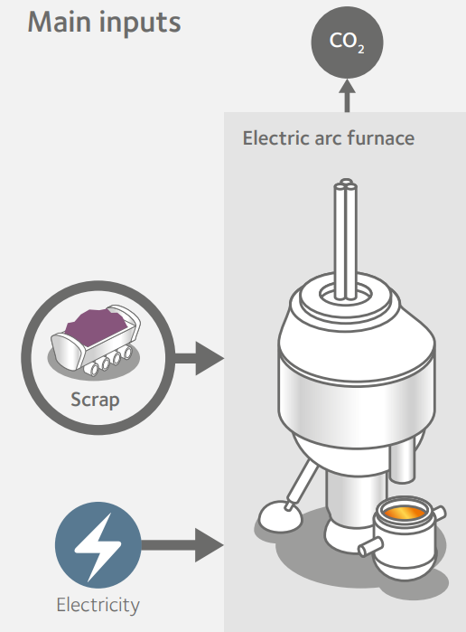
Scrap EAF is a cleaner steel making method that uses an Electric Arc Furnace to recycle scrap steel
Blast Furnace-Basic Oxygen Furnace (BF-BOF)
Process description
Scrap EAF takes collected scrap steel as input
An Electric Arc Furnace (EAF) converts electricity into heat which is used to melt scrap steel into crude steel
Observations
Scrap EAF accounts for 21% of global steel production, but use of technology is limited by the scarcity of scrap material
Cleanest conventional route, emitting 0.7 tonnes of CO2 per ton of steel (72% less than BF-BOF)
EU and US lead in scrap EAF production, accounting for ~40% of their steel production
Scrap EAF average cost of production of $415/ton – but cost fluctuates based on scrap and electricity prices
Source: AcelorMittal
Source: MIDREX (2021), ArcelorMittal (2021), World Steel Association (2021), IEEFA (2022), IEA Iron and Steel Technology Roadmap (2020), Columbia Center on Global Energy Policy (2021). Credit: Mimi Khawsam-ang, Max de Boer, Grace Frascati & Gernot Wagner (22 February 2024); share/adapt with attribution. Contact: gwagner@columbia.edu

Slide 13
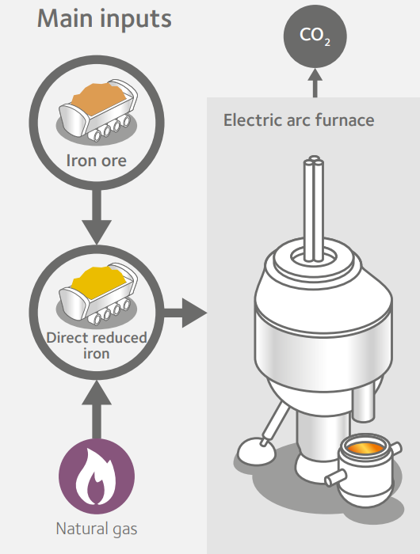
DRI-EAF is less common and uses natural gas to reduce iron ore to pure iron, which then enters into an EAF to make crude steel
Natural Gas-Based Direct Reduced Iron – Electric Arc Furnace (NG DRI-EAF)
Process description
Iron ore is mixed with natural gas in a Direct Reduced Iron (DRI) shaft to perform iron reduction and obtain pure iron
The iron is then fed into an Electric Arc Furnace (EAF) where it is converted into crude steel
Observations
DRI-EAF accounts for remaining 7% of global steel production and is most dominant in the Middle East and Africa, where gas is cheap and abundant
Natural gas is a cleaner reduction agent than coal. DRI-EAF on average emits 1.4 tons of CO2 per tonne of crude steel, 40% less than BF-BOF
DRI-EAF is the most expensive conventional production route at $455/ton
Source: AcelorMittal
Source: MIDREX (2021), ArcelorMittal (2021), World Steel Association (2021), IEEFA (2022), IEA Iron and Steel Technology Roadmap (2020). Credit: Mimi Khawsam-ang, Max de Boer, Grace Frascati & Gernot Wagner (22 February 2024); share/adapt with attribution. Contact: gwagner@columbia.edu

Slide 14
India is one of the fastest growing steel producers, and set to continue use of blast furnaces to meet rapid demand
India’s new crude steel production capacity (2021 – 2038E)
Observations
India is now the world’s second largest producer of crude steel, and it has typically been a net exporter post FY2016-17, apart from economic downturns
Because of continued investment, India’s steel making capacity is expected to hit 300 mm tonnes per annum by 2030-31
To meet demand, India is set to build at least 200 MTPA of new fossil-fuel based, emission-intensive steel production capacity over the next 15 years
68% of this capacity is expected to be blast furnaces
Remaining 32% expected to be from other processes like integrated BF + BOF
New crude steel production capacity in India ’announced’ or ‘under construction’ (in million tonnes per annum)
Integrated BF + BOF
62
Integrated DRI (coal) + EAF
Integrated BF/DRI (coal) + BOF/EAF/IF
Other
40
36
32
25
24
2
17
8
9
1
9
1
1
2
3
2021
2022
2023
2024
2025
2026
2028
2029
2030
2032
2036
2038
Source: India Steel – The Indian Steel Industry. Climate Policy Initiative – Taking Stock of Steel. Credit: Max de Boer, Grace Frascati & Gernot Wagner (22 February 2024); share/adapt with attribution. Contact: gwagner@columbia.edu

Slide 15
Global iron and steel emissions expected to rise without intervention; future reduction scenarios will require drastic cuts
Only with intervention will CO₂e from iron and steel decline into 2050
Observations
If no action is taken, global emissions from the iron and steel sector are expected to peak at 2.7 gigatonnes per year in 2050
Increase in emissions attributable to growing steel demand from emerging economies
Over time, gradual shift in demand is expected from China to India, Southeast Asia and Africa
The International Energy Agency (IEA) has developed several possible pathways for the steel industry:
In the 90% reduction by 2070 pathway, emissions would still need to drop by 50% by 2050
In the net-zero emissions by 2050 pathway, emissions would already need to drop by 25% by 2030, and drop to close to zero by 2050
Direct CO₂ emissions in the iron and steel sector per IEA scenario (in Gt Co₂ per year)
3.5
Baseline
90% reduction by 2070 (IEA)
3.0
Net Zero Emissions by 2050 (IEA)
2.5
2.4
2.0
1.5
1.0
0.5
0.0
2020
2030
2050
Notes: Baseline scenario reflects the policies and implementing measures that have been adopted as of September 2022 NZE = Net Zero Emissions. Source: IEA (2020), IEA Net Zero by 2050 (2021), IEA Iron and Steel Technology Roadmap (2020), McKinsey (2023). Credit: Mimi Khawsam-ang, Max de Boer, Grace Frascati & Gernot Wagner (22 February 2024); share/adapt with attribution. Contact: gwagner@columbia.edu

Slide 16
BF-BOF is the cheapest production method, but regional cost differences impact margins across production methods
Regional cost differences cause all steel making methods to be competitive
Observations
Profit margins across the industry are slim – the average EBITDA margin of steel producers over the past 10 years was 8-10%
Raw material and fuel prices can cause strong fluctuations in margins, given that these typically make up between 60-80% of total production costs
While some of these markets are global (iron ore), others are more regional (e.g. electricity, scrap steel) which can drive regional cost differences
Labor costs, feeding into fixed OPEX, are typically higher in advanced economies than in emerging economies
CAPEX for production equipment is usually consistent across regions. However, engineering, procurement and construction costs can vary significantly
Simplified levelized cost breakdown of crude steel production via conventional routes (in USD per tonne, 2020)
700
Raw materials
Fixed OPEX
Regional cost variations
Fuel
CAPEX
590
Avg. 2019
steel price*
600
510
500
460
455
390
415
20%
400
28%
11%
17%
10%
7%
16%
300
14%
23%
Raw material and fuel costs typically make up 60-80% of production costs
20%
200
72%
100
46%
44%
0
BF-BOF
Scrap EAF
DRI-EAF
(*) Average steel price based on Hot Rolled Coil Steel Futures Continuous Contract (HRN00), average of 2019 monthly prices. Source: MarketWatch (2019) McKinsey,IEA Iron and Steel Technology Roadmap (2020), European Commission Joint Research Centre Science for Policy Report (2016). Credit: Mimi Khawsam-ang, Max de Boer, Grace Frascati & Gernot Wagner (22 February 2024); share/adapt with attribution. Contact: gwagner@columbia.edu

Slide 17
Downstream activities post-crude steelmaking use process heat and represent <20% of total steel production emissions
Downstream steelmaking process
Observations
On average, <20% of steelmaking CO2 emissions come from downstream processes
Metallurgy involves adding alloys in hot ladle to convert base crude steel into different types of refined steel (carbon, alloy, stainless, or tool)
Common alloys: manganese, chromium, cobalt, nickel, tungsten, molybdenum, vanadium
Refining step traps and removes impurities through processes like stirring molten steel with gas like argon
Continuous casting molds liquid steel into semi-finished products, usually slabs, billets, or blooms
Finally, the steel goes through a number of different finishing processes (e.g. hot or cold rolling, galvanizing) depending on the intended end use of the steel
Molten, Base Crude Steel
Metallurgy & Refining Stage
Refined Steel Grades
Carbon (“Structural”) Steel
Alloy Steel
Stainless Steel
Tool Steel
Low to high carbon steels
Strong, durable, & affordable
Uses: building & construction, manufacturing
Low to high alloy steels
Easily machinable, heat & corrosion resistant
Uses: oil & gas pipelines, auto panels, kitchenware
10%-20% of chromium, nickel, or molybdenum
Corrosion resistant, low maintenance, sanitary
Uses: medical devices, food processing
Designed specifically for tools & dies
Hard & wear-resistant
Uses: cutting & drilling equipment, auto cylinder heads, aerospace blades
Continuous Casting
Semi-Finished Products: Slabs, Billets, Blooms
Final Rolling
Hot-Rolled Products: Coils, Plates, Sections, Tubes, Rods, Wires, etc.
Source: World Steel Association, Association for Iron & Steel Technology, Eziil, Industrial Metal Supply, Steel Manufacturer’s Association Steelmaking Emissions Report (2022). Credit: Mimi Khawsam-ang, Max de Boer, Grace Frascati & Gernot Wagner (22 February 2024); share/adapt with attribution. Contact: gwagner@columbia.edu

Slide 18
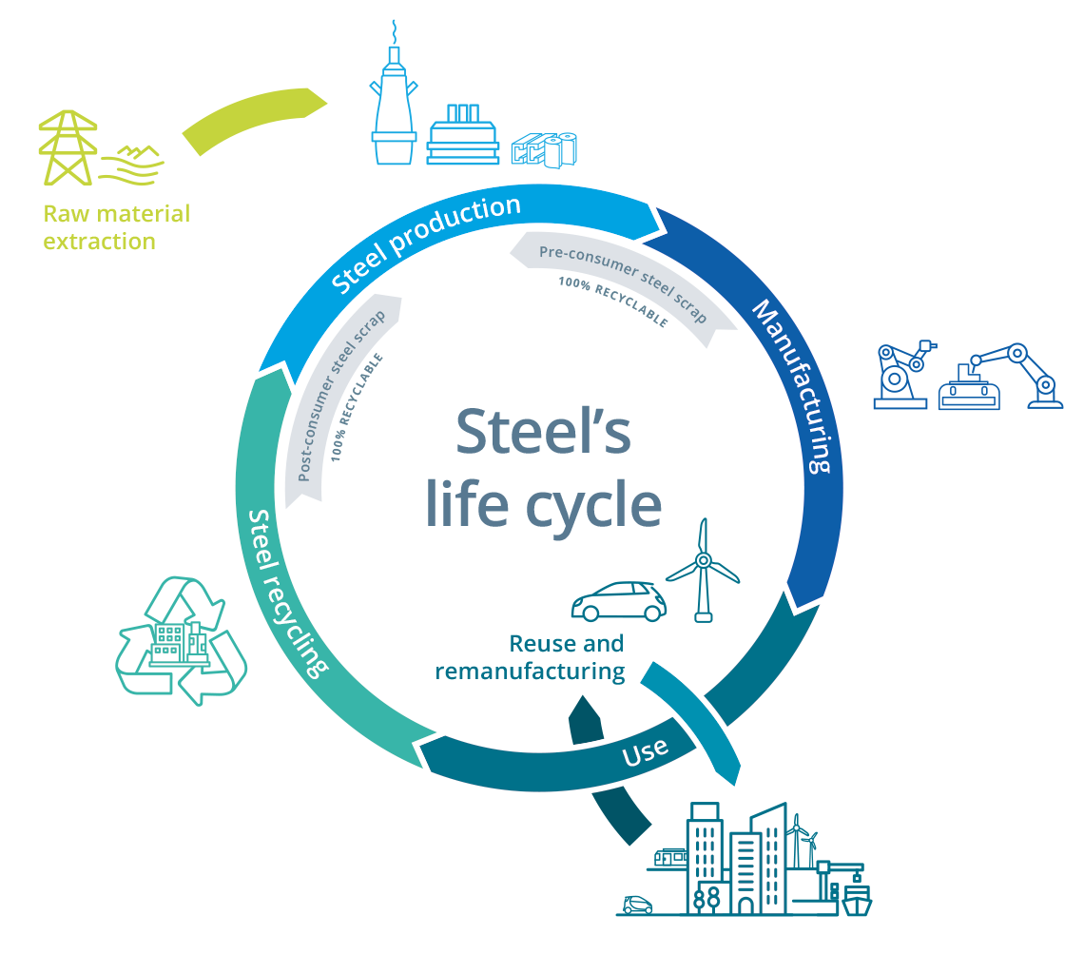
Steel 100% recyclable material; increased use of scrap in primary and secondary routes expected to help decarbonize sector
Observations
Steel is 100% recyclable and can be infinitely reused. Its magnetic properties allow easy separation from waste streams
Scrap EAF lowest-CO2 is the least emitting and least energy intensive conventional route and is also cost competitive
As a share of steelmaking, Scrap EAF expected to grow from 22% today to almost 50% by 2050 in Net Zero scenario
Use of scrap as additional metallic inputs in conventional BF-BOF and DRI-EAF possible and proven: EAFs can use up to 100% of steel scrap, and BOFs up to 30%
Scrap separated into two categories: pre-consumer scrap (scrap from downstream steel manufacturing) and post-consumer scrap (~50/50 split)
As a share of steelmaking, Scrap EAF expected to grow from 22% today to almost 50% by 2050 in Net Zero scenario
Over 85% of steel is recycled today, world’s most recycled material. Scrap steel supply only grows as steel products become obsolete
The scrap steel market is already well-functioning, and expectations are that as scrap becomes more expensive there will be more incentives to recover steel from difficult applications such as foundations
Source: World Steel Association
Source: World Steel Association (2020), World Steel Association Scrap use in the steel industry (2021), World Steel Association Fact sheet: Raw materials in the steel industry (2023), Net Zero Steel (2021), Mission Possible Partnership Net Zero Steel Sector Transition Strategy (2021), IEEFA (2021), World Economic Forum (2023). Credit: Mimi Khawsam-ang, Max de Boer, Grace Frascati & Gernot Wagner (22 February 2024); share/adapt with attribution. Contact: gwagner@columbia.edu

Slide 19
Among major steel producing countries and regions, Asian economies lag in scrap steel consumption
Scrap steel consumption varies regionally but lags places like India and China
Observations
Average lifespan of a steel product is ~40 years, but with a wide range. Steel packaging (such as tin-coated steel cans) lasts only a few weeks on average, while steel used for buildings may last 100 or more years
This long life-span means that scrap steel is still scarce in emerging economies, as these countries industrialized later
Usually, local scrap steel recycling markets feed the domestic steel industry. But there is some international trade taking place:
Turkey, the world’s 7th largest steel producer, imported over 90% of their scrap steel inputs
The EU and the US are both large exporters of scrap steel
Scrap steel consumption as a share of crude steel production by major producing countries and regions (in %)
100
80
60
58
40
36
35
35
Global average
20
0
Turkey
USA
EU-27
Russia
South Korea
Japan
Africa
Central & South America
Middle East
India
China
Crude steel share of global production
2% | 4% | 7% | 4% | 3% | 5% | 1% | 3% | 3% | 7% | 54%
Source: Bureau of International Recycling World Steel Recycling in Figures 2017-2021 (2021), IEA Iron and Steel Technology Roadmap (2020), World Steel Association Scrap use in the steel industry (2021), World Steel Association World Steel in Figures 2023 (2023), IEEFA New From Old: The Global Potential for More Scrap Steel Recycling (2021). Credit: Mimi Khawsam-ang, Max de Boer, Grace Frascati & Gernot Wagner (22 February 2024); share/adapt with attribution. Contact: gwagner@columbia.edu

Slide 20
Scrap steel stock is expected to continue growing globally, allowing for more markets to increase scrap steel recycling
Growing amount of scrap steel to alleviate demand in emerging economies like China
Observations
Domestic scrap availability to increase significantly in emerging economies over the coming years
As China matures, it is expected to fuel much of global scrap steel supply through 2050
Today, steel stock in OECD nations has reached 12-13 tonnes per capita, while in India and Africa this is only 1 tonne per capita – meaning less scrap steel is likely to become available in India and Africa over time
As scrap availability improves, adoption of Scrap EAF and a growing share of scrap steal in total steel production become more feasible
Global scrap steel availability by major regions, 2017-2050 (in mm)
EU + NAFTA* + Japan
1,340
China
Rest of world
1,020
750
2017
2030
2050
(*) Canada, Mexico and USA. Source: World Steel Association (2018), World Steel Association Scrap use in the steel industry (2021), IEEFA New From Old: The Global Potential for More Scrap Steel Recycling (2021). Credit: Mimi Khawsam-ang, Max de Boer, Grace Frascati & Gernot Wagner (22 February 2024); share/adapt with attribution. Contact: gwagner@columbia.edu

Slide 21
Steel Decarbonization Technologies

Slide 22
Key messages Steel decarbonization technologies
Several emerging deep decarbonization steelmaking technologies now exist:
Green hydrogen DRI-EAF: hydrogen produced using zero-carbon electricity is used as iron ore reductant instead of natural gas. Second step still uses an Electric Arc Furnace (EAF)
Iron ore electrolysis: use of electricity to split pure iron from iron ore. Two technologies:
Molten Oxide Electrolysis (MOE): a high current is run through a mixture of iron ore and a liquid electrolyte. The current causes the iron ore to split into oxygen and molten iron
Electrowinning-EAF (EF-EAF): iron from iron ore is dissolved in an acid, which leaves behind impurities. The iron-rich solution is electrocuted to form pure solid iron, which is melted in an EAF
Carbon Capture, Utilization and Storage (CCUS): BF-BOF and DRI-EAF can be retrofitted with point capture equipment. Captured carbon is then used or stored
These technologies produce steel with over 90% less CO₂ emissions compared to conventional processes. However, green hydrogen DRI-EAF and CCUS BF-BOF / DRI-EAF come at a green price premium. CCUS is also less viable for BF route given difficulty to capture all carbon that’s released. Electrolysis may be cheaper than conventional processes, but has not been tested at scale yet
There are also some emerging transitional steelmaking technologies with lower decarbonization potential:
Modifications to existing BF-BOF and DRI-EAF: using biomass as input, switching to zero-carbon electricity, partial green hydrogen injections
Different production process: Smelting Reduction-BOF (SM-BOF)
Decarbonization potential of transitional technologies ranges between 10-50%, while they still come with a considerable green premium
Credit: Mimi Khawsam-ang, Max de Boer, Grace Frascati, and Gernot Wagner (22 February 2024); share/adapt with attribution. Contact: gwagner@columbia.edu

Slide 23
Most steel production uses BF-BOF, scrap EAF, and NG DRI-EAF, with Green H₂ DRI-EAF, iron ore electrolysis, and CCUS technologies emerging
Scrap EAF: Scrap metal is melted in an electric arc furnace using electrical energy
2
Iron ore electrolysis: Molten oxide electrolysis runs a current through iron ore and liquid electrolyte to split ore into pure molten iron; electrowinning-EAF dissolves iron from iron ore in acid, then electrifies it from solid iron
Iron ore
Iron
Steel
BF-BOF: Iron ore, coke, and limestone produce iron in a blast furnace, which is turned into steel in an oxygen furnace
NG DRI-EAF: Iron ore turns into iron using natural gas, which is then melted in an EAF to produce steel
3
Carbon capture, utilization, and storage (CCUS): Equipment is added to existing steel-producing infrastructure to capture emitted CO₂, which is then sequestered or reused
1
Green H₂ DRI-EAF: Green hydrogen replaces natural gas as an iron ore reductant; water instead of CO₂ is generated as a byproduct
See glossary. Sources: World Steel Association; IEEFA (2022); IEA, Iron and Steel Technology Roadmap (2020); Steel Technology, Basic Oxygen Furnace Steelmaking; Recycling Today, Growth of EAF Steelmaking; Wildsight, Do We Really Need Coal to Make Steel. Credit: Mimi Khawsam-ang, Max de Boer, Grace Frascati, and Gernot Wagner (22 February 2024); share/adapt with attribution. Contact: gwagner@columbia.edu

Slide 24
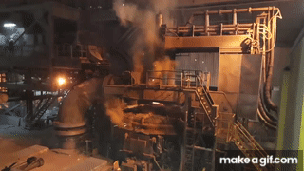
Green H₂ DRI-EAF is an emerging technology using green hydrogen instead of natural gas as an iron ore reductant with standard electric arc furnaces
1
Green H₂ direct reduced iron-EAF has an average cited decarbonization potential of ~90%
Observations
BF-BOF: Iron ore, coke, and limestone produce iron in a blast furnace, which is turned into steel in an oxygen furnace
Scrap EAF: Scrap metal is melted in an EAF using electrical energy
NG DRI-EAF: Iron ore turns into iron using natural gas, which is then melted in an EAF to produce steel
Green H₂ DRI-EAF: Green hydrogen replaces natural gas as an iron ore reductant; byproduct is water vs. CO₂
Iron ore
Iron
Steel
Renewable electricity is used throughout the production process, including the creation of green hydrogen
Comes at a green price premium
Sources: World Steel Association; IEEFA (2022); IEA, Iron and Steel Technology Roadmap (2020); Steel Technology, Basic Oxygen Furnace Steelmaking; Recycling Today, Growth of EAF Steelmaking; Wildsight, Do We Really Need Coal to Make Steel. Credit: Mimi Khawsam-ang, Max de Boer, Grace Frascati, and Gernot Wagner (22 February 2024); share/adapt with attribution. Contact: gwagner@columbia.edu

Slide 25
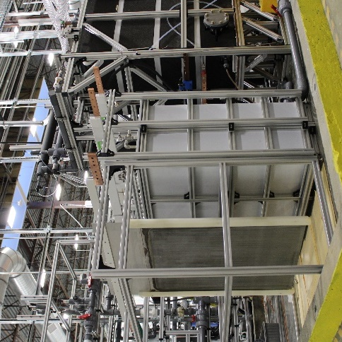
Iron ore electrolysis is an emerging technology that uses an electric current to drive a chemical reaction, producing molten iron or pure solid iron
2
Iron ore electrolysis has an average cited decarbonization potential of ~97%
Observations
BF-BOF: Iron ore, coke, and limestone produce iron in a blast furnace, which is turned into steel in an oxygen furnace
Scrap EAF: Scrap metal is melted in an electric arc furnace (EAF) using electrical energy
NG DRI-EAF: Iron ore turns into iron using natural gas, which is then melted in an EAF to produce steel
Green H₂ DRI-EAF: Green hydrogen replaces natural gas as an iron ore reductant; byproduct is water vs. CO₂
Iron ore electrolysis: Molten oxide electrolysis runs a current through iron ore and liquid electrolyte to split ore into pure molten iron; electrowinning-EAF dissolves iron from iron ore in acid, then electrifies it to form solid iron
Iron is now akin to solid-state battery, allowing for a reversed process that produces electricity
Iron ore
Iron
Steel
Electrowinning-EAF dissolves iron from iron ore in acid, then electrifies it to form pure solid iron; molten oxide electrolysis runs a current through iron ore and liquid electrolyte to split ore into pure molten iron
May be cheaper than conventional processes but has not yet been proven at scale
Sources: World Steel Association; IEEFA (2022); IEA, Iron and Steel Technology Roadmap (2020); Steel Technology, Basic Oxygen Furnace Steelmaking; Recycling Today, Growth of EAF Steelmaking; Wildsight, Do We Really Need Coal to Make Steel. Credit: Mimi Khawsam-ang, Max de Boer, Grace Frascati, and Gernot Wagner (13 March 2024); share/adapt with attribution. Contact: gwagner@columbia.edu

Slide 26
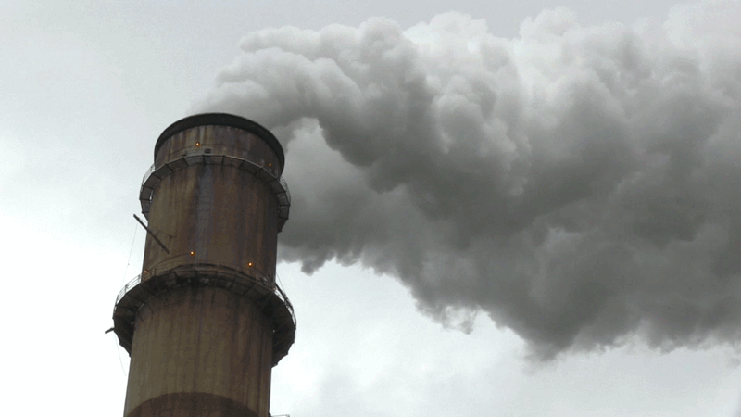
Carbon capture, utilization, and storage (CCUS) is an emerging technology that reduces steel’s carbon footprint by capturing released CO₂
3
Despite a cited ~90% decarbonization potential, CCUS technology is largely unproven
Observations
BF-BOF: Iron ore, coke, and limestone produce iron in a blast furnace, which is turned into steel in an oxygen furnace
Scrap EAF: Scrap metal is melted in an electric arc furnace using electrical energy
NG DRI-EAF: Iron ore turns into iron using natural gas, which is then melted in an EAF to produce steel
Green H₂ DRI-EAF: Green hydrogen replaces natural gas as an iron ore reductant; byproduct is water vs. CO₂
Iron ore electrolysis: Molten oxide electrolysis runs a current through iron ore and liquid electrolytes to split ore into pure molten iron; electrowinning-EAF dissolves iron from iron ore in acid, then electrifies it to form solid iron
CCUS: Equipment is added to existing steel-producing infrastructure to capture emitted CO_{2,} to then sequester or reuse
Iron ore
Iron
Steel
Less viable for the blast furnace route given difficulty of capturing all carbon released
Capture rates range from 50%-90%, and viability is debated due to the lack of a single capture point
Sources: World Steel Association; IEEFA (2022); IEA, Iron and Steel Technology Roadmap (2020); Steel Technology, Basic Oxygen Furnace Steelmaking; Recycling Today, Growth of EAF Steelmaking; Wildsight, Do We Really Need Coal to Make Steel. Credit: Mimi Khawsam-ang, Max de Boer, Grace Frascati, and Gernot Wagner (22 February 2024); share/adapt with attribution. Contact: gwagner@columbia.edu

Slide 27
Green H₂, electrolysis, and CCUS could reduce steelmaking CO₂ emissions by over 85% if implemented at scale
1
2
3
 | 100% Green Hydrogen (H2) DRI-EAF | Iron Ore Electrolysis | Carbon Capture, Utilization, and Storage (CCUS)
Description | Green hydrogen replaces natural gas as an iron ore reductant in DRI shaft; the rest of the process remains the same Generates water as a byproduct instead of CO₂ | Two different processes are possible: Molten oxide electrolysis: High current runs through mixture of iron ore and liquid electrolyte to split ore into pure molten iron Electrowinning-EAF: Iron from iron ore is dissolved in acid. Iron-rich solution is then electrified to form pure solid iron | CCUS equipment can be added to existing steel-producing infrastructure to capture emitted CO₂ Captured CO₂ is then sequestered underground or reused
Real-time sector initiatives | HYBRIT 100% fossil fuel-free DRI-EAF production with green H₂ used for DRI | Electra Electrowinning to produce high-purity iron plates ready for EAF input (no DRI or MOE step) | ArcelorMittal Carbalyst® captures carbon from a blast furnace and reuses it as bio-ethanol. However, technology not proven at scale
Applicability to conventional routes | Applicable to existing DRI-EAF route, with minor retrofitting | Full overhaul of BF-BOF equipment required; replacement of DRI shaft in DRI-EAF | Retrofitting of capture technology is possible on conventional BF-BOF and DRI-EAF
Decarbonization potential (vs. BF-BOF) | ~90% | ~97% | ~90%
Estimated production cost (excl. CapEx) | <$800 per tonne of steel | ~$215 per tonne of iron + cost of ‘stranded’ iron ore | ~$380 – 400 per tonne
Hypothetical best-case scenario
Sources: Columbia Center on Global Energy Policy (2021); IEA, Iron and Steel Technology Roadmap (2020); McKinsey (2020); Mining Technology (2023); Tata Steel; Primetals Technologies;
Edie, ArcelorMittal accused of net-zero greenwashing (2023). Credit: Mimi Khawsam-ang, Max de Boer, Grace Frascati, and Gernot Wagner (13 March 2024); share/adapt with attribution.
Contact: gwagner@columbia.edu

Slide 28
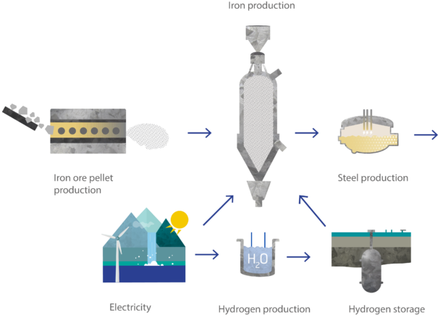
In green hydrogen DRI-EAF, hydrogen replaces natural gas as reductant to create pure iron, with water as the main byproduct
100% Green H₂ DRI-EAF production process
Description
Hydrogen is used as a reductant instead of natural gas to transform iron ore into solid, purified iron. After this, the iron is moved to an electric arc furnace where it is transformed into crude steel
Instead of CO₂, the main byproduct of this production process is water
For the process to be CO₂ neutral, two important criteria must be met
The electricity used to power the electric arc furnace should come from a renewable source
The hydrogen used in the production process should be green hydrogen
Hydrogen sourcing
Hydrogen can be produced in several ways, not all of which are CO₂ neutral
Green hydrogen: produced from water electrolysis using 100% renewable electricity – zero-carbon option
Grey hydrogen: produced from natural gas, methane, or other carbon-containing feedstock
Blue hydrogen: similar to grey hydrogen, but with carbon capture (capture rate of 85-95%) – low-carbon, but not zero-carbon, option
Source: HYBRIT
Source: Columbia Center on Global Energy Policy (2021), HYBRIT, HYBRIT Media Bank, World Economic Forum (2021), Department of Energy. Credit: Mimi Khawsam-ang, Max de Boer, Grace Frascati & Gernot Wagner (22 February 2024); share/adapt with attribution. Contact: gwagner@columbia.edu

Slide 29
Global green hydrogen production needs to expand significantly for green hydrogen DRI-EAF to become feasible
Green hydrogen production needs to grow at a rapid rate
Observations
Hydrogen already produced commercially today, but currently only 1% produced using renewable energy
New green hydrogen production should be built close to renewable energy suppliers like solar and wind farms
Production can then even be synced to ramp up when solar and/or wind energy is available
Strong policy support for green hydrogen is expected to help scaling efforts. For example, in the US tax code section 45V provides tax credits for hydrogen production
Blue hydrogen production projected to grow in regions with abundant natural gas resources to help kickstart the global hydrogen economy. Peak production expected in 2040
Low and zero-carbon hydrogen production for Net Zero scenario by Deloitte, 2030-2050 (in mm tonnes)
600
598
Green hydrogen
Blue hydrogen
500
503
406
400
300
290
200
172
100
0
2030
2035
2040
2045
2050
Source: Deloitte Green hydrogen: Energizing the path to Net Zero (2023), Washington Post (2023), IRENA (2021). Credit: Mimi Khawsam-ang, Max de Boer, Grace Frascati & Gernot Wagner (22 February 2024); share/adapt with attribution. Contact: gwagner@columbia.edu

Slide 30
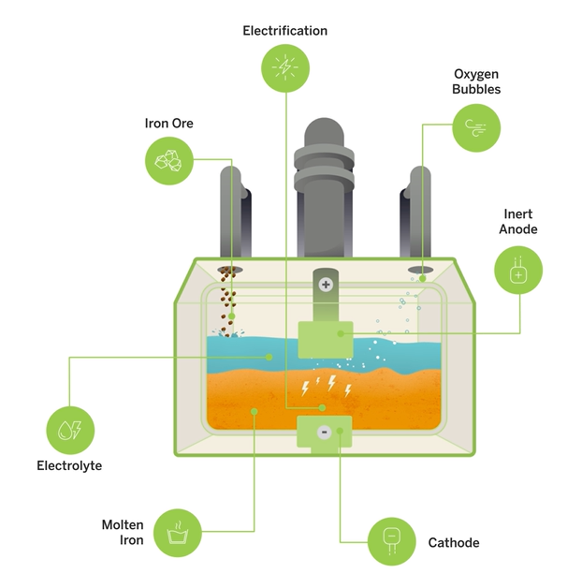
Molten Ore Electrolysis uses electricity to transform iron ore into pure molten iron ready for refining
Molten Ore Electrolysis (MOE) is a one-step steelmaking process
Process description
In a Molten Ore Electrolysis (MOE) reactor, iron ore is combined with an electrolyte, and a strong electrical current is applied to initiate the electrolysis process
The result of this process is molten iron, which is immediately suitable for transfer to the refining stage. In this subsequent stage, carbon and other elements are added to transform the molten iron into refined steel
The only significant byproduct from this process is oxygen (O₂), coming from the iron oxide in the iron ore
MOE power consumption per tonne of steel (13 GJ / tonne) is considerably less than that of BF-BOF (24 GJ / tonne)
For the process to be completely carbon neutral, electricity used to power the reactor should come from renewable sources
Source: Boston Metal
Source: Boston Metal, Mining Technology (2023), Mission Possible Partnership Net Zero Steel Sector Transition Strategy (2021)
Credit: Mimi Khawsam-ang, Max de Boer, Grace Frascati & Gernot Wagner (22 February 2024); share/adapt with attribution. Contact: gwagner@columbia.edu

Slide 31
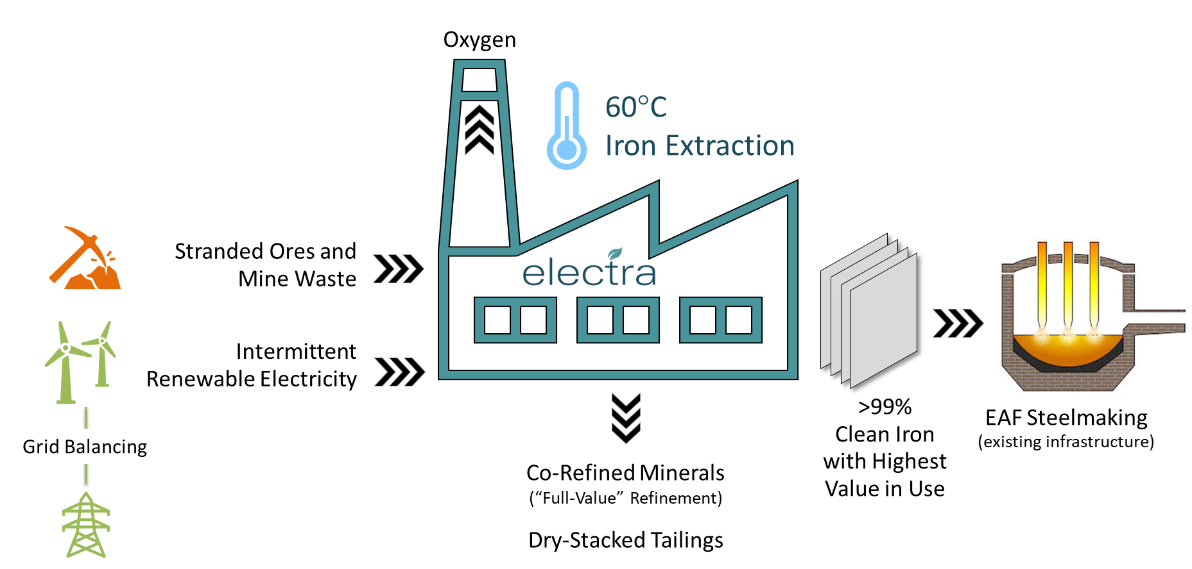
In electrowinning-EAF, an iron-rich solution is electrified to create pure grade iron ready to be used in an electric arc furnace
Electrowinning produces pure iron at low temperatures ready for EAFs
Process description
Iron ore is dissolved into an acid to create a stable iron-rich liquid while removing ore impurities. An electric current is then applied to extract iron from this liquid, releasing oxygen but no CO₂
Electrowinning at 60°C (140F), enables low-cost intermittent renewables and energy demand responsiveness, lowering OpEx.
High-impurity, otherwise stranded ores (> 1 billion tonnes available globally) lower OpEx and CapEx in the ore-to-metal value chain, producing co-product revenue
Product is 99.9% pure iron metal, allowing for premium steelmaking with contaminated scrap in EAFs at lower costs
Source: Electra
Source: Lopes et al. (2022), Mining Technology (2023), Mission Possible Partnership Net Zero Steel Sector Transition Strategy (2021)
Credit: Mimi Khawsam-ang, Max de Boer, Grace Frascati & Gernot Wagner (22 February 2024); share/adapt with attribution. Contact: gwagner@columbia.edu

Slide 32
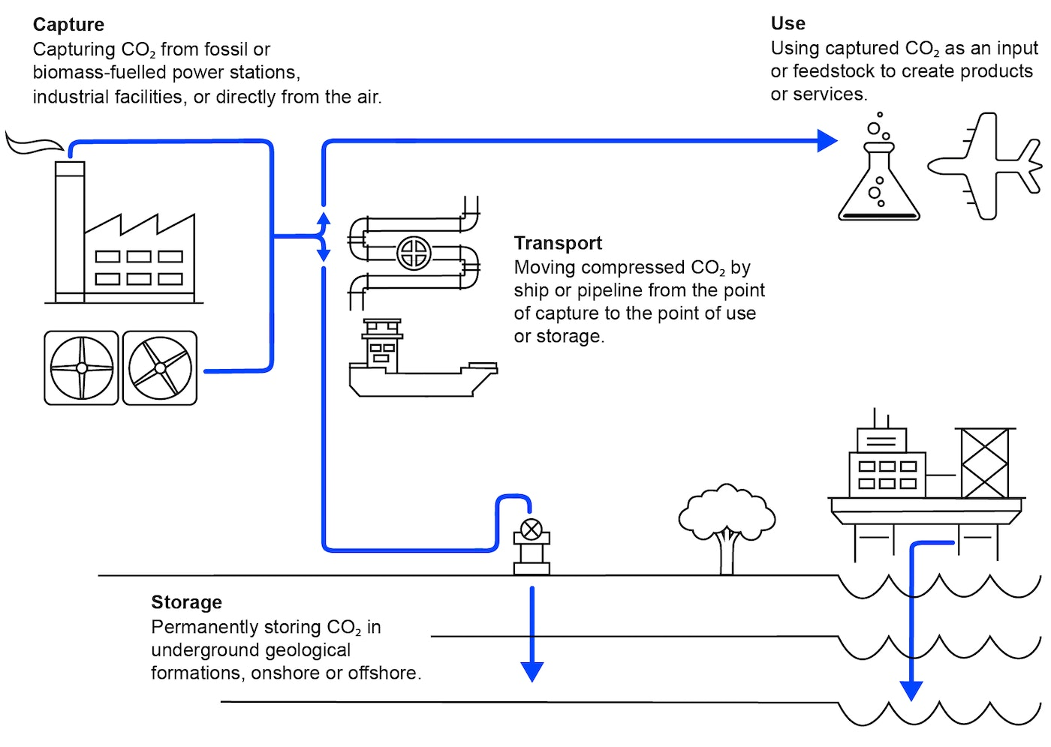
Carbon capture and storage technologies available, but CCUS remains unproven for use on blast furnaces
Captured carbon either stored or used as feedstock
Carbon capture
In theory, point capture technologies can be retrofitted onto BF-BOF and DRI-EAF
CO₂ is primarily captured from the shafts of both Blast Furnaces and Direct Reduced Iron reactors, and at the end of the crude steelmaking process
Capture rates up to 90%, but efficacy varies, with some systems as low as 50%
Carbon utilization and storage
CO₂ is commonly stored in rock formations deep underground to ensure long-term sequestration
While the majority of captured CO₂ is currently used for enhanced oil recovery, other emerging applications include feedstock for synthetic fuels, chemicals, and building materials
CCUS Drawbacks
Despite CCUS innovation, viability of CCUS for blast furnace is hotly contested due to absence of a single, harnessable carbon egress point on a blast furnace and the scarcity of pure carbon
Despite a few small pilot projects, no full-scale CCUS facilities for blast-furnace steelmaking are operational anywhere
Source: IEA
Sources: IEA Energy Technology Perspectives (2020), IEA Transforming Industry through CCUS (2017), IEA Iron and Steel Technology Roadmap (2020), Global CCS Institute (2017), MIT (2021),
International Journal of Greenhouse Gas Control Volume 61 (2017), IEA Greenhouse Gas R&D Program (2017), Primetals Technologies, Edie – ArcelorMittal accused of net-zero greenwashing. Credit:
Mimi Khawsam-ang, Max de Boer, Grace Frascati & Gernot Wagner (22 February 2024); share/adapt with attribution. Contact: gwagner@columbia.edu

Slide 33
Green H₂, electrolysis, and CCUS could reduce steelmaking CO₂ emissions by over 85% if implemented at scale
All discussed technologies have a CO₂ reduction potential of >85%
Observations
A key enabler for green steel production is an abundance of green electricity, which is required for both powering electrolysis and the production of green hydrogen
Assuming the current global electricity mix does not change, H₂ DRI-EAF would have a decarbonization potential of only 60% instead of >85% when 100% green electricity is used
The 90% CO₂ reduction for CCUS is a hypothetical best-case scenario, which at present has not been proven at scale
Crude steelmaking CO₂ emissions reduction potential of deep decarbonization technologies relative to conventional BF-BOF and NG DRI-EAF routes (in %)
100
97
96
Hypothetical best-case scenario
80
60
40
20
0
Green H₂ DRI-EAF
(Zero-carbon elec.)
Electrolysis
(Zero-carbon elec.)
CCUS Additions
CO₂ Reduction Potential (vs. Conventional BF-BOF)
CO₂ Reduction Potential (vs. Conventional NG DRI-EAF)
Sources: Columbia Center on Global Energy Policy (2021); American Institute of Chemical Engineers (2023); Electra; Boston Metal; Midrex (2021); International Journal of Greenhouse Gas Control Volume 61 (2017); Mission Possible Partnership Net Zero Steel Sector Transition Strategy (2021). Credit: Mimi Khawsam-ang, Max de Boer, Grace Frascati, and Gernot Wagner (22 February 2024); share/adapt with attribution. Contact: gwagner@columbia.edu

Slide 34
Steel decarbonization technologies, however, often come with a green premium and require large amounts of green energy
Green technologies often come at a green premium
Observations
Green H₂ DRI-EAF
Green H₂ prices are expected to fall >50%, to $2.20-$2.90 per kg by 2030, making H₂ DRI-EAF adoption much more attractive
Switching from BF-BOF to green H₂ DRI-EAF is costly without government support. CapEx required for a new plant ranges from $1.1 billion to $1.7 billion and operating expenses are higher
Electrolysis/Electrowinning
Claimed cost savings compared to conventional steel production methods are still uncertain due to the nascency of technology
At present, there is not enough green electricity available on grids to support large-scale electrolysis-based steelmaking
CCUS
According to the IEA, CCUS retrofits are at present the most advanced and cost-effective low-carbon solutions for the steel industry
Adding CCUS technology to existing plants is expected to require only minor modifications
Average steel production cost estimates per technology (excluding CapEx) at current price levels (USD per tonne)
1,000
Decarbonization technologies
Hypothetical best-case scenario
Conventional technologies
800
600
400
~380
~365
200
0
Green H2 DRI-EAF
CCUS (DRI-EAF)
CCUS (BF-BOF)
DRI-EAF
BF-BOF
Electrolysis
Note: Electrolysis costs are assumed to see a 15% reduction relative to BF-BOF. Carbon capture costs as $25/tonne-CO₂ with a ~90% capture rate. Green H₂ price at $6.40/kg. Sources: Columbia Center on Global Energy Policy (2021); Boston Metal; MIT (2018); Journal of Cleaner Production Volume 389 (2023); IEA, Is carbon capture too expensive? (2021); McKinsey (2020); Nature Energy (2022); IEA, Iron and Steel Technology Roadmap (2020). Credit: Mimi Khawsam-ang, Max de Boer, Grace Frascati, and Gernot Wagner (13 March 2024); share/adapt with attribution. Contact: gwagner@columbia.edu

Slide 35
Other transitional decarbonization technologies take less time and effort to implement but have lower decarbonization potential
 | MODIFICATIONS TO BF-BOF / DRI-EAF PROCESSES |  |  | NEW PRODUCTION PROCESS
 | Biomass as input | Switch to zero-carbon electricity | Partial green hydrogen injections | Smelting Reduction BOF (SR-BOF)
Process description | Biomass used as substitute for coal in BF-BOF Biosyngas used as substitute for natural gas in DRI shaft | Switch from fossil-fueled electricity to 100% green electricity >60% electricity generation is fossil fuel-based today | Injection of hydrogen (~5-10%) to reduce coal use in BF Injection of hydrogen (~30%) to reduce natural gas use in DRI shaft | Production process that eliminates need for coke making and iron ore sintering Emits less CO₂ than regular BF-BOF
Decarbonization potential (vs. BF-BOF) | ~40% | ~5 – 40% | ~20% | ~20%
Estimated production costs / tonne (excl. CAPEX) | ~$455 – 700 | ~$345 – 435 | ~$375 – 495 | ~$310
Limits to decarbonization | Insufficient sustainable biomass is likely available to enable a global transition to this production method | Direct process emissions from BF-BOF and DRI-EAF are not addressed | There is a limit to how much H₂ can be injected without replacing production equipment | Coal, a primary input, emits CO₂, but smelting reduction-BOF provides a concentrated CO₂ stream, ideal for capture
Source: IEA Iron and Steel Technology Roadmap (2020), World Steel Association (2021), Energy Institute Statistical Review of World Energy (2023), Columbia Center on Global Energy Policy (2021)
Journal of Cleaner Production Volume 393 (2023). Credit: Mimi Khawsam-ang, Max de Boer, Grace Frascati & Gernot Wagner (22 February 2024); share/adapt with attribution.
Contact: gwagner@columbia.edu

Slide 36
Transitional decarbonization technologies only achieve CO₂ reductions of up to 50%
Transitional technologies have limited decarbonization potential
Observations
Switching to biomass input assumes the use of sustainably-sourced biomass. Using biomass with large carbon footprint will offset achieved reductions
Switching to zero-carbon electricity sources is necessary to power deep decarbonization technologies such as electrolysis, but switching to zero-carbon electricity alone will only have limited effect
Replacing a BF-BOF setup with a smelting reduction-BOF route requires high CAPEX and still emits more CO₂ than DRI-EAF
However, CO₂ stream from smelting reduction-BOF is typically highly concentrated, making it ideal for carbon capture
CO₂ emissions reduction potential relative to conventional BF-BOF and NG DRI-EAF routes (in %)
100
CO₂ Reduction Potential (vs. Conventional BF-BOF)
CO₂ Reduction Potential (vs. Conventional NG DRI-EAF)
80
60
40
38
20
0
-20
-18
Biomass Input
Zero-Carbon Electricity Switch
10% Green H₂
BF-BOF
30% Green H₂
DRI-EAF
Smelting Reduction - BOF
Note: methane leakage not accounted for in gas substitution methods. Source: Columbia Center on Global Energy Policy (2021), MIDREX (2020), Tata Steel Europe (2020). Credit: Mimi Khawsam-ang, Max de Boer, Grace Frascati & Gernot Wagner (22 February 2024); share/adapt with attribution. Contact: gwagner@columbia.edu

Slide 37
Transitional technologies also come with green premiums, possibly locking in uneconomical pathways
Most transitional technologies also have considerable green premiums
Observations
DRI-EAF sees a higher jump in costs when switching to zero-carbon electricity than BF-BOF because the Electric Arc Furnace (EAF) runs only on electricity
To use biomass in the DRI-EAF process biomass has to be gasified to turn it into biosyngas, which leads to higher estimated costs
A number of these transitional technologies result in higher production costs per tonne of steel than when CCUS is installed on BF-BOF or DRI-EAF
It is however important to again note that CCUS for blast furnaces has not yet been proven to work at scale
Furthermore, these numbers do not include CAPEX, which is likely to be considerable for a CCUS installation
Avg. steel production cost estimates (excl. CAPEX) for transitional technologies applied to BF-BOF (in USD / tonne)
1,000
Conventional technologies
Transitional technologies
750
500
~450
250
0
BF-BOF
10% green H2 BF-BOF
Zero-carbon electricity (BF-BOF)
Biomass (BF-BOF)
Smelting Reduction BOF (BF-BOF)
Avg. steel production cost estimates (excl. CAPEX) for transitional technologies applied to DRI-EAF (in USD / tonne)
1,000
750
~700
500
~365
~435
250
0
DRI-EAF
30% green H2 DRI-EAF
Zero-carbon electricity (DRI-EAF)
Biomass (DRI-EAF)
Smelting Reduction BOF (DRI-EAF)
Note: assumes hydrogen price of $6.64 per kg. Source: Columbia Center on Global Energy Policy (2021), MIDREX (2020), IEA Iron and Steel Technology Roadmap (2020). Credit: Mimi Khawsam-ang, Max de Boer, Grace Frascati & Gernot Wagner (22 February 2024); share/adapt with attribution. Contact: gwagner@columbia.edu

Slide 38
Adoption trends & obstacles

Slide 39
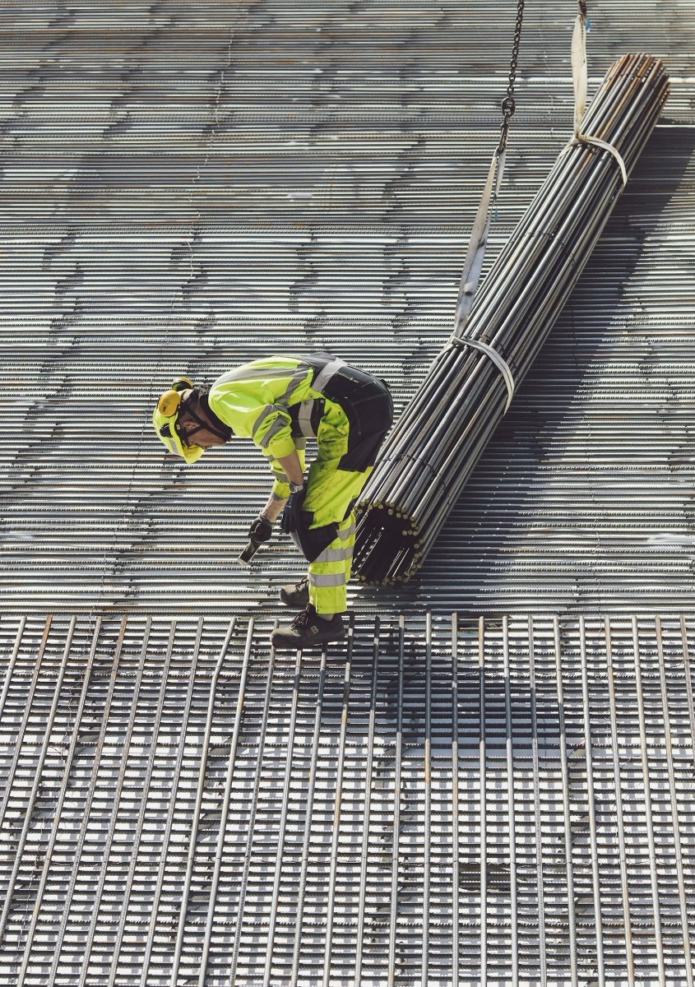
Key messages Steel’s future
Reaching net zero by 2050 would require a ~25% emissions reduction by 2030
Policymakers can and should step in to assist with green technologies, such as H2 Green Steel’s and Electra’s new generation plants
The focus should be on creating low-cost, low-carbon electricity and on driving down capital costs for new technologies
A production tax credit for low-emission iron would support electrolysis as well as green H₂
Time is of the essence, as Asia’s large fleet of high-carbon legacy blast furnaces (~75% of global iron production) are due for costly relining in the next 10 years. This presents an opportunity to instead invest in newer, greener technologies
Credit: Mimi Khawsam-ang, Max de Boer, Grace Frascati, and Gernot Wagner (22 February 2024); share/adapt with attribution. Contact: gwagner@columbia.edu

Slide 40
BF and EAF, bolstered by China, lead global steel capacity, while other technologies – including clean – constitute <10%
Global steel capacity in 2023: 2.27 billion tonnes
62%
29%
9%
100%
Other
16%
Brazil 1%
Other
37%
80%
Germany 2%
U.S. 13%
Russia 4%
South Korea 4%
Luxembourg 5%
60%
India 6%
South Korea 4%
Japan 7%
India 5%
Italy 5%
Russia 5%
40%
Luxembourg 6%
Iran 7%
China
53%
Japan 7%
20%
U.S. 9%
China
15%
0%
Blast Furnace (BF)
Electric Arc Furnace (EAF)
Other
Source: Global Energy Monitor – Global Steel Plant Tracker Credit: Mimi Khawsam-ang, Max de Boer, Grace Frascati & Gernot Wagner (22 February 2024); share/adapt with attribution. Contact: gwagner@columbia.edu

Slide 41
IEA expects technology transition to take off after 2030, and CCUS to play the biggest role in 2050 of all green steel technologies
IEA expects scrap steel recycling to play a significant role by 2050
Observations
The International Energy Agency (IEA) expects limited decarbonization progress until 2030, with only a slight increase in scrap EAF production and first production using green hydrogen and electrolysis
Scrap steel electric arc furnace (EAF) is expected to become the most used production method for steel by 2050 ─ taking 46% market share
In the IEA’s scenario, the remaining 54% is split between green hydrogen, electrolysis-based production, and CCUS-equipped production
It should be noted that the effectiveness of carbon capture, utilization, and storage on blast furnaces is still challenged and debated within the steel industry
Production of crude steel by technology in IEA net zero scenario, 2022-2050 (in %)
100%
80%
60%
40%
20%
0%
2022
2030
2050
Scrap EAF
Green Hydrogen DRI-EAF
CCUS-Equipped
BF-BOF
Other (inc. Bioenergy)
Electrolysis-Based
NG DRI-EAF
Sources: IEA (2022); IEA, Net Zero by 2050 (2021); IEEFA (2022): Net Zero Steel (2021). Credit: Mimi Khawsam-ang, Max de Boer, Grace Frascati, and Gernot Wagner (22 February 2024); share/adapt with attribution. Contact: gwagner@columbia.edu

Slide 42
Mission Possible Partnership, on the other hand, expects green hydrogen and bioenergy to drive decarbonization
Iron and steel sector breakdown of Mission Possible Partnership (MPP) decarbonization route from 2020 to 2050
Annual iron and steel sector CO₂ emissions (Scope 1 & 2) reduction by decarbonization route (in Gt CO₂)
The Mission Possible Partnership is an industry coalition aimed at sparking the net-zero transformation of seven industrial sectors (including the steel sector)
0.25
0.00
2020 Emissions
BAU emissions increase
2050 Emissions (BAU)
Increased scrap steelmaking
Transitional technologies
Iron reduction w. natural gas, green hydrogen or bioenergy
CCUS
2050 Sector Residual Emissions
CO2 removals (e.g. DAC)
Net Zero
Notes: BAU = Business as usual, assuming production route mix as of 2020 maintained; Increased scrap steelmaking refers to increase in both Scrap EAF production and use of scrap in primary
production routes; DAC = direct air carbon capture. Sources: Mission Possible Partnership Making Net Zero Steel Possible (2022). Credit: Mimi Khawsam-ang, Max de Boer, Grace Frascati & Gernot Wagner (22 February 2024); share/adapt with attribution. Contact: gwagner@columbia.edu

Slide 43
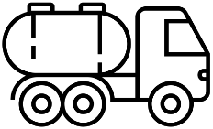
Besides green premiums, there are other barriers preventing the adoption of green steel technologies (1/2)
Infrastructure and equipment risk
Transport and storage cost of CO₂
Stranded asset risk
Existing conventional plant equipment worldwide has an average age of only 13-14 years (<50% of the typical lifetime of 40 years)
Overhaul of production routes for to transition to Net Zero could result in $345-$518B of stranded assets
Stranded assets expected to be concentrated in Asia, particularly China and India
Green infrastructure, especially zero-carbon electricity generation and hydrogen production capacity, have to expand significantly to enable the steel industry to transition
Electrolysis technologies are nascent –production equipment still needs to be proven successful at mass scale
As it relates to global carbon storage, demand is outpacing storage space development
Without increased efforts to accelerate CO₂ storage development, the availability of CO₂ storage could become a bottleneck to CCUS deployment, alongside aforementioned drawbacks, like unproven technology
Sources: IEA CO2 Transport and Storage, IEA Iron and Steel Technology Roadmap (2020), Financial Times (2022), McKinsey (2020), McKinsey Transition to Net Zero: Steel (2022), US DoE Oak Ridge National Laboratory; icons via Noun Project. Credit: Mimi Khawsam-ang, Max de Boer, Grace Frascati & Gernot Wagner (22 February 2024); share/adapt with attribution. Contact: gwagner@columbia.edu

Slide 44
Besides green premiums, there are other barriers preventing the adoption of green steel technologies (2/2)
A consensus definition for green steel and iron
Limited governmental support
Dwindling steel workforce
Pressing need for unified definition of green steel and green iron, as diverse approaches are currently being pursued
Having shared definitions is crucial, but of course, no single definition can accommodate all perspectives
Insufficient educational and training opportunities for the steel industry’s workforce
Declining interest in younger generations to pursue careers in this field
Those that are interested typically gravitate toward green steel, meaning employees in the grey steel space are dwindling
Transitioning to new production technologies expected to cost $4.4T over ~30 years
Production costs per tonne of steel could rise by 30% driven by higher OPEX and required CAPEX of green hydrogen and CCUS technologies
At present, there is limited governmental support to incentivize producers to adopt greener production routes
Sources: IEA CO2 Transport and Storage, IEA Iron and Steel Technology Roadmap (2020), Financial Times (2022), McKinsey (2020), McKinsey Transition to Net Zero: Steel (2022), US DoE Oak Ridge National Laboratory; icons via Noun Project. Credit: Mimi Khawsam-ang, Max de Boer, Grace Frascati & Gernot Wagner (22 February 2024); share/adapt with attribution. Contact: gwagner@columbia.edu

Slide 45
Appendix

Slide 46
Glossary
BAU | Business as usual
BF-BOF | Blast Furnace-Basic Oxygen Furnace
CAPEX | Capital expenditure(s)
CCUS | Carbon capture, utilization & storage
CO | Carbon monoxide
CO₂ | Carbon dioxide
CO₂e | CO₂ equivalent, using global warming potential as conversion factor
DAC | Direct Air Capture
DRI-EAF | Direct Reduced Iron-Electric Arc Furnace production process
EAF | Electric Arc Furnace
EBITDA | Earnings before interest, taxes, depreciation, and amortization
EW-EAF | Electrowinning-Electric Arc Furnace
Gt | Gigatonne, equal to 1 billion metric tonnes
H₂ | Hydrogen
IEA | International Energy Agency
HRC | Hot Rolled Coil (type of finished steel product)
MPP | Mission Possible Partnership – industry decarbonization coalition
MOE | Molten oxide electrolysis
NG | Natural gas
NAFTA | North American Free-Trade Agreement
NG | Natural gas
NG DRI-EAF | DRI-EAF production process using natural gas
NZE | Net Zero Emissions
O₂ | Oxygen
OECD | The Organization for Economic Cooperation and Development
OPEX | Operational expenditure(s)
SR-BOF | Smelting Reduction-Basic Oxygen Furnace
Tonne | Metric ton

