Slide 1
Decarbonizing Steel Overview
13 March 2024
Mimi Khawsam-ang, Max de Boer, Grace Frascati & Gernot Wagner

Slide 2
Steel sector overview: The problem

Slide 3
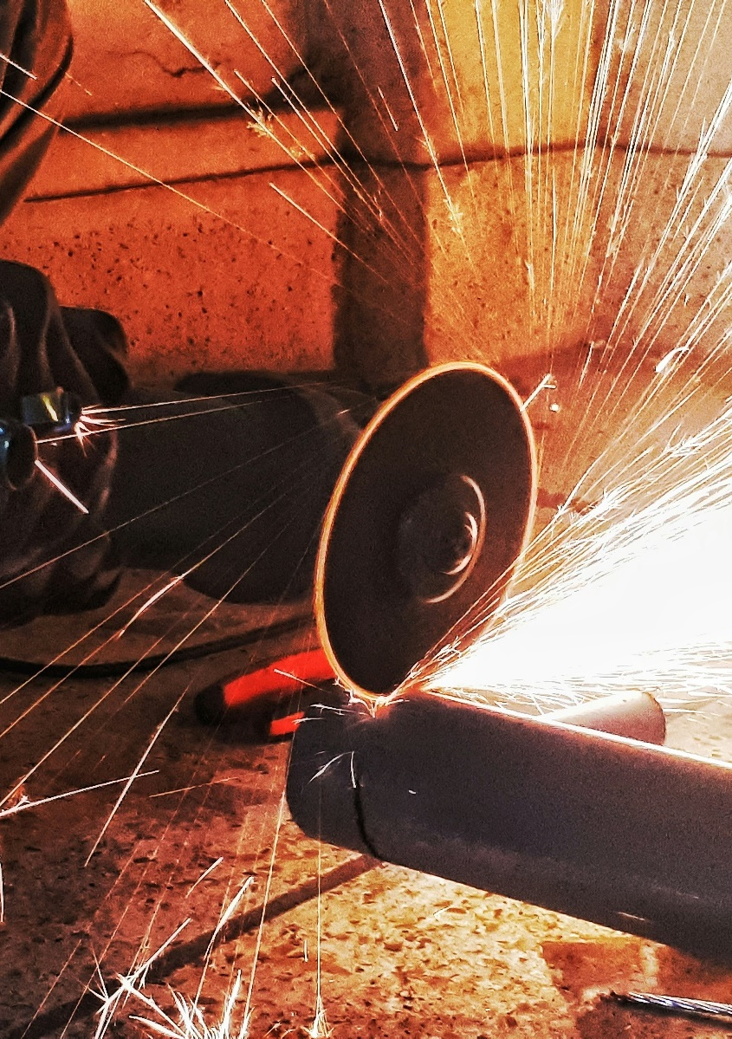
Key messages Steel sector overview
The global steel sector is responsible for approximately 10% of global CO₂e emissions
Global steel emissions have more than doubled since 2000 (from 1.2 gigatonnes in 2000 to 2.5 gigatonnes in 2021). However, emissions have started to decouple from production levels since 2016
Without intervention, emissions are expected to continue growing due to rising demand from emerging economies. Reaching net zero by 2050 would require a 25% emission reduction by 2030
Steel is currently produced through three main production routes, all of which emit CO₂:
Blast furnace-basic oxygen furnace (BF-BOF): 72% of global steel production. It uses coke and limestone to produce pure iron from iron ore in a blast furnace, which is then turned into steel in an oxygen furnace
Scrap electric arc furnace (scrap EAF): 21% of global steel production. Scrap metal is melted in an EAF using electrical energy
Natural gas-based direct reduced iron-electric arc furnace (NG DRI-EAF): 7% of global steel production. Iron ore is turned into iron using natural gas, which is then melted in an EAF to produce steel
On average, BF-BOF is the cheapest production method ($390 per tonne vs. $415 for scrap EAF and $455 for NG DRI-EAF). However, regional variations in costs (such as for raw material and fuel) make all three methods competitive
Downstream activities after crude steelmaking (e.g., refining, casting, rolling) represent less than 20% of the total steel production emissions
Because steel is a 100% recyclable material, increased use of scrap metal can help decarbonize the steel sector
Credit: Mimi Khawsam-ang, Max de Boer, Grace Frascati, and Gernot Wagner (22 February 2024); share/adapt with attribution. Contact: gwagner@columbia.edu

Slide 4
Steel sector scope 1 and 2 emissions are ~10% of global emissions
CO₂e emissions in 2021: 50.1 billion tonnes
Scope 1
Scope 2
29%
29%
20%
15%
7%
100%
Non-metallic minerals 2%
Non-ferrous metals 2%
Oil 4%
Agricultural fuel combustion 4%
Other 2%
Rail 1%
Refining 4%
Aviation 9%
Commercial
combustion
21%
Commercial combustion 7%
Natural gas
22%
Land use, land-use change, and
forestry 14%
80%
Chemicals
13%
Marine 11%
Waste
21%
HFCs from
refrigeration
and A/C
25%
Iron and steel
16%
60%
Cement
17%
Crops
28%
40%
Coal
74%
Road
77%
Residential
combustion
54%
Oil and gas
20%
20%
Livestock
33%
Remaining industries
19%
Iron and steel
17%
0%
Industry
Power and heat
Agriculture, land use, and waste
Transport
Buildings
Sources: Scope 1 emissions from Rhodium Group ClimateDeck (September 2023); Scope 2 iron and steel estimate from IEA (2023). Credit: Mimi Khawsam-ang, Max de Boer, Grace Frascati, and Gernot Wagner (22 February 2024); share/adapt with attribution. Contact: gwagner@columbia.edu

Slide 5
Global steel emissions have more than doubled since 2000, with emission growth decoupled from production growth after 2016
Global CO₂e emissions decoupled from steel production post-2016
Observations
In recent years, the steel industry has made efforts to reduce its carbon footprint with more energy-efficient processes and technologies
Though not enough by itself, recycling rates have improved (sitting around 80%-90% globally)
Better manufacturing yields have made supply chains more efficient
Enhanced control processes and predictive maintenance strategies have led improvements in operational efficiency
China, the largest steel producer in the world, saw a 3% decline in steel output in 2021 and a similar decline in the years since
Global CO₂e emissions from iron and steel production (in gigatonnes)
Global steel production (in million tonnes)
4
2,000
Steel production
Iron and steel production emissions
3
1,500
2
1,000
1
500
0
0
’00
‘01
’02
‘03
‘04
‘05
‘06
’07
‘08
‘09
‘10
‘11
‘12
‘13
‘14
‘15
‘16
‘17
‘18
‘19
‘20
‘21
Note: The majority of the world’s iron is used to make steel. Sources: Rhodium Group ClimateDeck (September 2023); World Steel Association; McKinsey, Decarbonization Challenge for Steel; IEA, CO₂ Emissions in 2022, Reuters, China 2021 Crude Steel Output. Credit: Mimi Khawsam-ang, Max de Boer, Grace Frascati, and Gernot Wagner (22 February 2024); share/adapt with attribution. Contact: gwagner@columbia.edu

Slide 6
Crude steel is now produced through three main methods that all emit CO₂:
1
Blast furnace-basic oxygen furnace (BF-BOF), which alone produces ~80% of iron & steel CO₂
Scrap electric arc furnace (EAF), limited to recycled scrap
Natural gas-based direct reduced iron-electric arc furnace (NG DRI-EAF) most expensive, least used
2
3

Slide 7
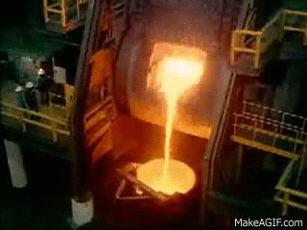
Of three main steelmaking methods, blast furnace-basic oxygen furnace (BF-BOF) is the cheapest, most popular, and most polluting
1
BF-BOF ~73% of global steel production and ~80% of iron and steel CO₂ emissions
Observations
BF-BOF: Iron ore, coke, and limestone produce iron in a blast furnace, which is turned into steel in an oxygen furnace
Iron ore
Iron
Steel
2.33 tonnes of CO₂ per tonne of steel
FeO₂ + coal = Fe + CO₂
Sources: World Steel Association; IEEFA (2022); IEA, Iron and Steel Technology Roadmap (2020); Steel Technology, Basic Oxygen Furnace Steelmaking; Recycling Today, Growth of EAF Steelmaking; Wildsight, Do We Really Need Coal to Make Steel. Credit: Mimi Khawsam-ang, Max de Boer, Grace Frascati, and Gernot Wagner (22 February 2024); share/adapt with attribution. Contact: gwagner@columbia.edu

Slide 8
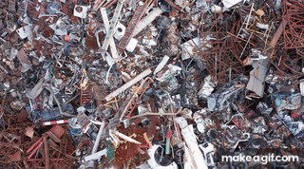
Of the three main steelmaking methods, scrap electric arc furnace (EAF) is the cleanest, though limited by the scarcity of scrap material
2
More than 80% of steel recycled; scrap EAF accounts for ~22% of global steel production
Observations
BF-BOF: Iron ore, coke, and limestone produce iron in a blast furnace, which is turned into steel in an oxygen furnace
Scrap EAF: Scrap metal is melted in an EAF using electrical energy
Iron ore
Iron
Steel
Produces 0.66 tonnes of CO₂ per tonne of crude steel, 72% less than BF-BOF
Takes collected scrap steel as input into an EAF
Sources: World Steel Association; IEEFA (2022); IEA, Iron and Steel Technology Roadmap (2020); Steel Technology, Basic Oxygen Furnace Steelmaking; Recycling Today, Growth of EAF Steelmaking; Wildsight, Do We Really Need Coal to Make Steel. Credit: Mimi Khawsam-ang, Max de Boer, Grace Frascati, and Gernot Wagner (22 February 2024); share/adapt with attribution. Contact: gwagner@columbia.edu

Slide 9
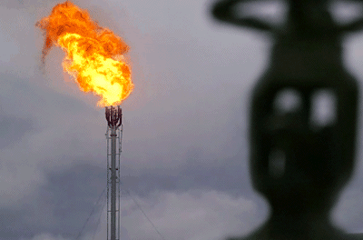
Of the three main steelmaking methods, natural gas-based direct reduced iron-electric arc furnace (NG DRI-EAF) is the most expensive and least used
3
BF-BOF ~73% of global steel production and 80% of iron and steel CO₂ emissions
Observations
BF-BOF: Iron ore, coke, and limestone produce iron in a blast furnace, which is turned into steel in an oxygen furnace
Scrap EAF: Scrap metal is melted in an EAF using electrical energy
NG DRI-EAF: Iron ore turns into iron using natural gas, which is then melted in an EAF to produce steel
Iron ore
Iron
Steel
Produces 1.39 tonnes of CO₂ per tonne of crude steel, 40% less than BF-BOF
Uses natural gas, a cleaner reduction agent than coal
Sources: World Steel Association; IEEFA (2022); IEA, Iron and Steel Technology Roadmap (2020); Steel Technology, Basic Oxygen Furnace Steelmaking; Recycling Today, Growth of EAF Steelmaking; Wildsight, Do We Really Need Coal to Make Steel. Credit: Mimi Khawsam-ang, Max de Boer, Grace Frascati, and Gernot Wagner (22 February 2024); share/adapt with attribution. Contact: gwagner@columbia.edu

Slide 10
At present, crude steel is produced through three main methods that all emit CO₂: BF-BOF, scrap EAF, and NG DRI-EAF
1
2
3
 | Blast Furnace-Basic Oxygen Furnace (BF-BOF) | Scrap Electric Arc Furnace (Scrap EAF) | Natural Gas-Based Direct Reduced Iron – Electric Arc Furnace (NG DRI-EAF)
Description | Iron ore, coke, and limestone produce pure iron in a blast furnace, which is turned into steel in an oxygen furnace | Scrap metal is melted in an EAF using electrical energy | Iron ore is turned into iron using natural gas, which is then melted in an EAF to produce steel
Main inputs | Iron ore, cooking coal | Scrap steel, electricity | Iron ore, natural gas
% of global steel production | 72% | 21% | 7%
CO2 per tonne of crude steel | 2.3 tonnes | 0.7 tonnes | 1.4 tonnes
Energy intensity per ton of crude steel | ~24 GJ | ~10 GJ | ~22 GJ
Average cost per tonne of crude steel | ~$390 | ~$415 | ~$455
Sources: World Steel Association; IEEFA (2022); IEA, Iron and Steel Technology Roadmap (2020); Steel Technology, Basic Oxygen Furnace Steelmaking; Recycling Today, Growth of EAF Steelmaking; Wildsight, Do We Really Need Coal to Make Steel. Credit: Mimi Khawsam-ang, Max de Boer, Grace Frascati, and Gernot Wagner (22 February 2024); share/adapt with attribution. Contact: gwagner@columbia.edu

Slide 11
Steel Decarbonization Technologies

Slide 12
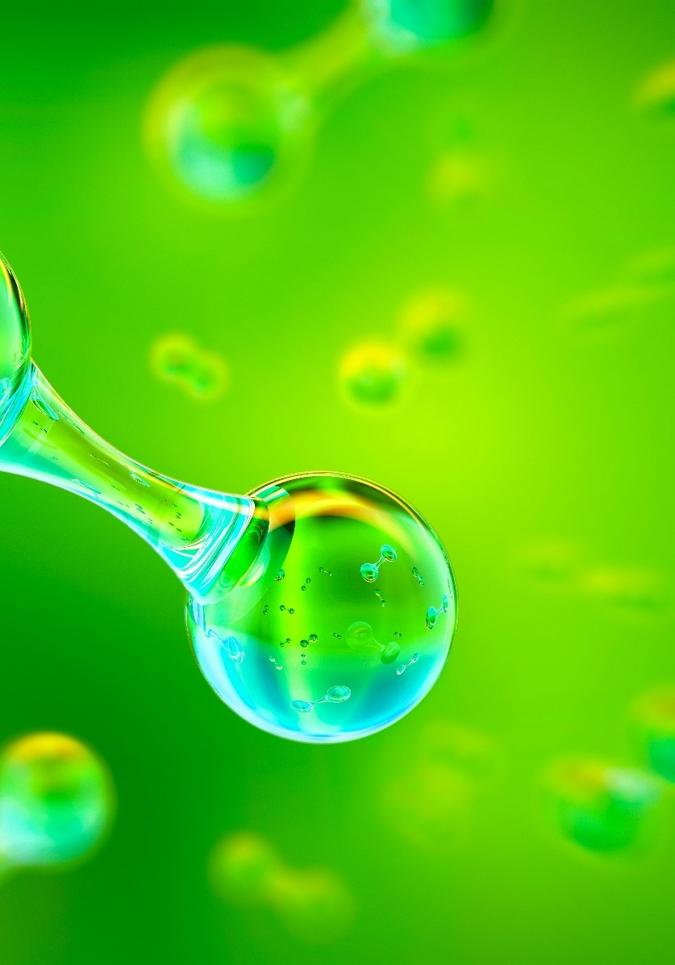
Key messages Steel decarbonization technologies
Several emerging deep decarbonization steelmaking technologies now exist:
Green hydrogen DRI-EAF: hydrogen produced using zero-carbon electricity is used as iron ore reductant instead of natural gas. Second step still uses an Electric Arc Furnace (EAF)
Iron ore electrolysis: use of electricity to split pure iron from iron ore. Two technologies:
Molten Oxide Electrolysis (MOE): a high current is run through a mixture of iron ore and a liquid electrolyte. The current causes the iron ore to split into oxygen and molten iron
Electrowinning-EAF (EF-EAF): iron from iron ore is dissolved in an acid, which leaves behind impurities. The iron-rich solution is electrocuted to form pure solid iron, which is melted in an EAF
Carbon Capture, Utilization and Storage (CCUS): BF-BOF and DRI-EAF can be retrofitted with point capture equipment. Captured carbon is then used or stored
These technologies produce steel with over 90% less CO₂ emissions compared to conventional processes. However, green hydrogen DRI-EAF and CCUS BF-BOF / DRI-EAF come at a green price premium. CCUS is also less viable for BF route given difficulty to capture all carbon that’s released. Electrolysis may be cheaper than conventional processes, but has not been tested at scale yet
There are also some emerging transitional steelmaking technologies with lower decarbonization potential:
Modifications to existing BF-BOF and DRI-EAF: using biomass as input, switching to zero-carbon electricity, partial green hydrogen injections
Different production process: Smelting Reduction-BOF (SM-BOF)
Decarbonization potential of transitional technologies ranges between 10-50%, while they still come with a considerable green premium
Credit: Mimi Khawsam-ang, Max de Boer, Grace Frascati, and Gernot Wagner (22 February 2024); share/adapt with attribution. Contact: gwagner@columbia.edu

Slide 13
Most steel production uses BF-BOF, scrap EAF, and NG DRI-EAF, with Green H₂ DRI-EAF, iron ore electrolysis, and CCUS technologies emerging
Scrap EAF: Scrap metal is melted in an electric arc furnace using electrical energy
2
Iron ore electrolysis: Molten oxide electrolysis runs a current through iron ore and liquid electrolyte to split ore into pure molten iron; electrowinning-EAF dissolves iron from iron ore in acid, then electrifies it from solid iron
Iron ore
Iron
Steel
BF-BOF: Iron ore, coke, and limestone produce iron in a blast furnace, which is turned into steel in an oxygen furnace
NG DRI-EAF: Iron ore turns into iron using natural gas, which is then melted in an EAF to produce steel
3
Carbon capture, utilization, and storage (CCUS): Equipment is added to existing steel-producing infrastructure to capture emitted CO₂, which is then sequestered or reused
1
Green H₂ DRI-EAF: Green hydrogen replaces natural gas as an iron ore reductant; water instead of CO₂ is generated as a byproduct
See glossary. Sources: World Steel Association; IEEFA (2022); IEA, Iron and Steel Technology Roadmap (2020); Steel Technology, Basic Oxygen Furnace Steelmaking; Recycling Today, Growth of EAF Steelmaking; Wildsight, Do We Really Need Coal to Make Steel. Credit: Mimi Khawsam-ang, Max de Boer, Grace Frascati, and Gernot Wagner (22 February 2024); share/adapt with attribution. Contact: gwagner@columbia.edu

Slide 14
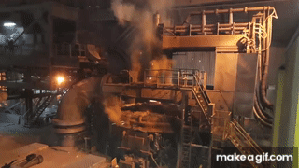
Green H₂ DRI-EAF is an emerging technology using green hydrogen instead of natural gas as an iron ore reductant with standard electric arc furnaces
1
Green H₂ direct reduced iron-EAF has an average cited decarbonization potential of ~90%
Observations
BF-BOF: Iron ore, coke, and limestone produce iron in a blast furnace, which is turned into steel in an oxygen furnace
Scrap EAF: Scrap metal is melted in an EAF using electrical energy
NG DRI-EAF: Iron ore turns into iron using natural gas, which is then melted in an EAF to produce steel
Green H₂ DRI-EAF: Green hydrogen replaces natural gas as an iron ore reductant; byproduct is water vs. CO₂
Iron ore
Iron
Steel
Renewable electricity is used throughout the production process, including the creation of green hydrogen
Comes at a green price premium
Sources: World Steel Association; IEEFA (2022); IEA, Iron and Steel Technology Roadmap (2020); Steel Technology, Basic Oxygen Furnace Steelmaking; Recycling Today, Growth of EAF Steelmaking; Wildsight, Do We Really Need Coal to Make Steel. Credit: Mimi Khawsam-ang, Max de Boer, Grace Frascati, and Gernot Wagner (22 February 2024); share/adapt with attribution. Contact: gwagner@columbia.edu

Slide 15
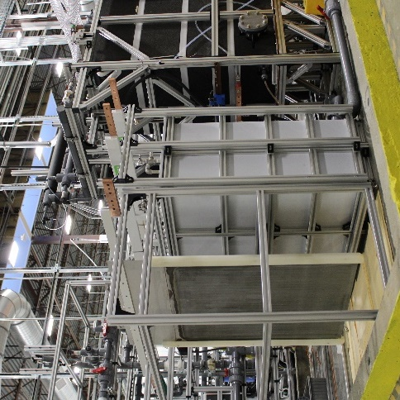
Iron ore electrolysis is an emerging technology that uses an electric current to drive a chemical reaction, producing molten iron or pure solid iron
2
Iron ore electrolysis has an average cited decarbonization potential of ~97%
Observations
BF-BOF: Iron ore, coke, and limestone produce iron in a blast furnace, which is turned into steel in an oxygen furnace
Scrap EAF: Scrap metal is melted in an electric arc furnace (EAF) using electrical energy
NG DRI-EAF: Iron ore turns into iron using natural gas, which is then melted in an EAF to produce steel
Green H₂ DRI-EAF: Green hydrogen replaces natural gas as an iron ore reductant; byproduct is water vs. CO₂
Iron ore electrolysis: Molten oxide electrolysis runs a current through iron ore and liquid electrolyte to split ore into pure molten iron; electrowinning-EAF dissolves iron from iron ore in acid, then electrifies it to form solid iron
Iron is now akin to solid-state battery, allowing for a reversed process that produces electricity
Iron ore
Iron
Steel
Electrowinning-EAF dissolves iron from iron ore in acid, then electrifies it to form pure solid iron; molten oxide electrolysis runs a current through iron ore and liquid electrolyte to split ore into pure molten iron
May be cheaper than conventional processes but has not yet been proven at scale
Sources: World Steel Association; IEEFA (2022); IEA, Iron and Steel Technology Roadmap (2020); Steel Technology, Basic Oxygen Furnace Steelmaking; Recycling Today, Growth of EAF Steelmaking; Wildsight, Do We Really Need Coal to Make Steel. Credit: Mimi Khawsam-ang, Max de Boer, Grace Frascati, and Gernot Wagner (13 March 2024); share/adapt with attribution. Contact: gwagner@columbia.edu

Slide 16
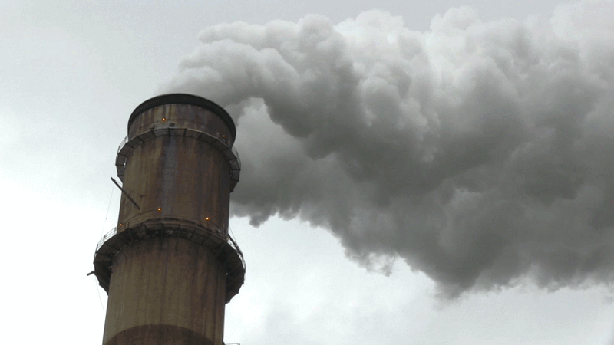
Carbon capture, utilization, and storage (CCUS) is an emerging technology that reduces steel’s carbon footprint by capturing released CO₂
3
Despite a cited ~90% decarbonization potential, CCUS technology is largely unproven
Observations
BF-BOF: Iron ore, coke, and limestone produce iron in a blast furnace, which is turned into steel in an oxygen furnace
Scrap EAF: Scrap metal is melted in an electric arc furnace using electrical energy
NG DRI-EAF: Iron ore turns into iron using natural gas, which is then melted in an EAF to produce steel
Green H₂ DRI-EAF: Green hydrogen replaces natural gas as an iron ore reductant; byproduct is water vs. CO₂
Iron ore electrolysis: Molten oxide electrolysis runs a current through iron ore and liquid electrolytes to split ore into pure molten iron; electrowinning-EAF dissolves iron from iron ore in acid, then electrifies it to form solid iron
CCUS: Equipment is added to existing steel-producing infrastructure to capture emitted CO_{2,} to then sequester or reuse
Iron ore
Iron
Steel
Less viable for the blast furnace route given difficulty of capturing all carbon released
Capture rates range from 50%-90%, and viability is debated due to the lack of a single capture point
Sources: World Steel Association; IEEFA (2022); IEA, Iron and Steel Technology Roadmap (2020); Steel Technology, Basic Oxygen Furnace Steelmaking; Recycling Today, Growth of EAF Steelmaking; Wildsight, Do We Really Need Coal to Make Steel. Credit: Mimi Khawsam-ang, Max de Boer, Grace Frascati, and Gernot Wagner (22 February 2024); share/adapt with attribution. Contact: gwagner@columbia.edu

Slide 17
Green H₂, electrolysis, and CCUS could reduce steelmaking CO₂ emissions by over 85% if implemented at scale
1
2
3
 | 100% Green Hydrogen (H2) DRI-EAF | Iron Ore Electrolysis | Carbon Capture, Utilization, and Storage (CCUS)
Description | Green hydrogen replaces natural gas as an iron ore reductant in DRI shaft; the rest of the process remains the same Generates water as a byproduct instead of CO₂ | Two different processes are possible: Molten oxide electrolysis: High current runs through mixture of iron ore and liquid electrolyte to split ore into pure molten iron Electrowinning-EAF: Iron from iron ore is dissolved in acid. Iron-rich solution is then electrified to form pure solid iron | CCUS equipment can be added to existing steel-producing infrastructure to capture emitted CO₂ Captured CO₂ is then sequestered underground or reused
Real-time sector initiatives | HYBRIT 100% fossil fuel-free DRI-EAF production with green H₂ used for DRI | Electra Electrowinning to produce high-purity iron plates ready for EAF input (no DRI or MOE step) | ArcelorMittal Carbalyst® captures carbon from a blast furnace and reuses it as bio-ethanol. However, technology not proven at scale
Applicability to conventional routes | Applicable to existing DRI-EAF route, with minor retrofitting | Full overhaul of BF-BOF equipment required; replacement of DRI shaft in DRI-EAF | Retrofitting of capture technology is possible on conventional BF-BOF and DRI-EAF
Decarbonization potential (vs. BF-BOF) | ~90% | ~97% | ~90%
Estimated production cost (excl. CapEx) | <$800 per tonne of steel | ~$215 per tonne of iron + cost of ‘stranded’ iron ore | ~$380 – 400 per tonne
Hypothetical best-case scenario
Sources: Columbia Center on Global Energy Policy (2021); IEA, Iron and Steel Technology Roadmap (2020); McKinsey (2020); Mining Technology (2023); Tata Steel; Primetals Technologies;
Edie, ArcelorMittal accused of net-zero greenwashing (2023). Credit: Mimi Khawsam-ang, Max de Boer, Grace Frascati, and Gernot Wagner (13 March 2024); share/adapt with attribution.
Contact: gwagner@columbia.edu

Slide 18
Green H₂, electrolysis, and CCUS could reduce steelmaking CO₂ emissions by over 85% if implemented at scale
All discussed technologies have a CO₂ reduction potential of >85%
Observations
A key enabler for green steel production is an abundance of green electricity, which is required for both powering electrolysis and the production of green hydrogen
Assuming the current global electricity mix does not change, H₂ DRI-EAF would have a decarbonization potential of only 60% instead of >85% when 100% green electricity is used
The 90% CO₂ reduction for CCUS is a hypothetical best-case scenario, which at present has not been proven at scale
Crude steelmaking CO₂ emissions reduction potential of deep decarbonization technologies relative to conventional BF-BOF and NG DRI-EAF routes (in %)
100
97
96
Hypothetical best-case scenario
80
60
40
20
0
Green H₂ DRI-EAF
(Zero-carbon elec.)
Electrolysis
(Zero-carbon elec.)
CCUS Additions
CO₂ Reduction Potential (vs. Conventional BF-BOF)
CO₂ Reduction Potential (vs. Conventional NG DRI-EAF)
Sources: Columbia Center on Global Energy Policy (2021); American Institute of Chemical Engineers (2023); Electra; Boston Metal; Midrex (2021); International Journal of Greenhouse Gas Control Volume 61 (2017); Mission Possible Partnership Net Zero Steel Sector Transition Strategy (2021). Credit: Mimi Khawsam-ang, Max de Boer, Grace Frascati, and Gernot Wagner (22 February 2024); share/adapt with attribution. Contact: gwagner@columbia.edu

Slide 19
Steel decarbonization technologies, however, often come with a green premium and require large amounts of green energy
Green technologies often come at a green premium
Observations
Green H₂ DRI-EAF
Green H₂ prices are expected to fall >50%, to $2.20-$2.90 per kg by 2030, making H₂ DRI-EAF adoption much more attractive
Switching from BF-BOF to green H₂ DRI-EAF is costly without government support. CapEx required for a new plant ranges from $1.1 billion to $1.7 billion and operating expenses are higher
Electrolysis/Electrowinning
Claimed cost savings compared to conventional steel production methods are still uncertain due to the nascency of technology
At present, there is not enough green electricity available on grids to support large-scale electrolysis-based steelmaking
CCUS
According to the IEA, CCUS retrofits are at present the most advanced and cost-effective low-carbon solutions for the steel industry
Adding CCUS technology to existing plants is expected to require only minor modifications
Average steel production cost estimates per technology (excluding CapEx) at current price levels (USD per tonne)
1,000
Decarbonization technologies
Hypothetical best-case scenario
Conventional technologies
800
600
400
~380
~365
200
0
Green H2 DRI-EAF
CCUS (DRI-EAF)
CCUS (BF-BOF)
DRI-EAF
BF-BOF
Electrolysis
Note: Electrolysis costs are assumed to see a 15% reduction relative to BF-BOF. Carbon capture costs as $25/tonne-CO₂ with a ~90% capture rate. Green H₂ price at $6.40/kg. Sources: Columbia Center on Global Energy Policy (2021); Boston Metal; MIT (2018); Journal of Cleaner Production Volume 389 (2023); IEA, Is carbon capture too expensive? (2021); McKinsey (2020); Nature Energy (2022); IEA, Iron and Steel Technology Roadmap (2020). Credit: Mimi Khawsam-ang, Max de Boer, Grace Frascati, and Gernot Wagner (13 March 2024); share/adapt with attribution. Contact: gwagner@columbia.edu

Slide 20
Other transitional decarbonization technologies take less time and effort to implement but have lower decarbonization potential
 | MODIFICATIONS TO BF-BOF / DRI-EAF PROCESSES |  |  | NEW PRODUCTION PROCESS
 | Biomass as input | Switch to zero-carbon electricity | Partial green hydrogen injections | Smelting Reduction BOF (SR-BOF)
Process description | Biomass used as substitute for coal in BF-BOF Biosyngas used as substitute for natural gas in DRI shaft | Switch from fossil-fueled electricity to 100% green electricity >60% electricity generation is fossil fuel-based today | Injection of hydrogen (~5-10%) to reduce coal use in BF Injection of hydrogen (~30%) to reduce natural gas use in DRI shaft | Production process that eliminates need for coke making and iron ore sintering Emits less CO₂ than regular BF-BOF
Decarbonization potential (vs. BF-BOF) | ~40% | ~5 – 40% | ~20% | ~20%
Estimated production costs / tonne (excl. CAPEX) | ~$455 – 700 | ~$345 – 435 | ~$375 – 495 | ~$310
Limits to decarbonization | Insufficient sustainable biomass is likely available to enable a global transition to this production method | Direct process emissions from BF-BOF and DRI-EAF are not addressed | There is a limit to how much H₂ can be injected without replacing production equipment | Coal, a primary input, emits CO₂, but smelting reduction-BOF provides a concentrated CO₂ stream, ideal for capture
Source: IEA Iron and Steel Technology Roadmap (2020), World Steel Association (2021), Energy Institute Statistical Review of World Energy (2023), Columbia Center on Global Energy Policy (2021)
Journal of Cleaner Production Volume 393 (2023). Credit: Mimi Khawsam-ang, Max de Boer, Grace Frascati & Gernot Wagner (22 February 2024); share/adapt with attribution.
Contact: gwagner@columbia.edu

Slide 21
Adoption trends & obstacles

Slide 22
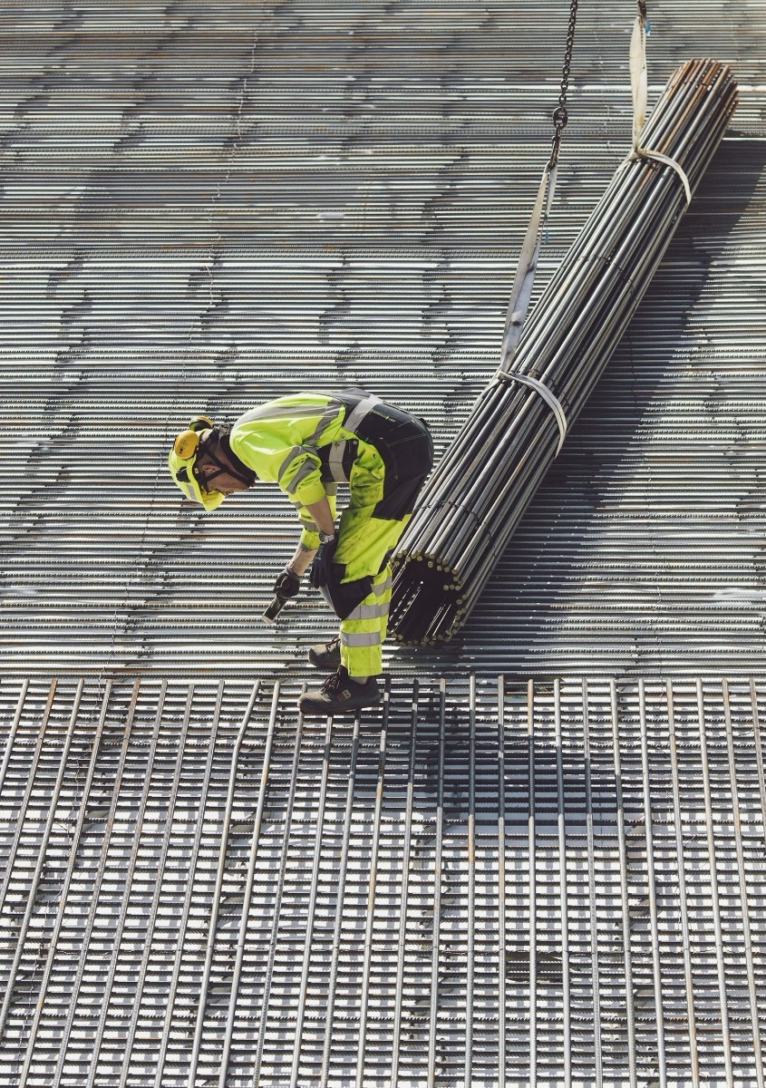
Key messages Steel’s future
Reaching net zero by 2050 would require a ~25% emissions reduction by 2030
Policymakers can and should step in to assist with green technologies, such as H2 Green Steel’s and Electra’s new generation plants
The focus should be on creating low-cost, low-carbon electricity and on driving down capital costs for new technologies
A production tax credit for low-emission iron would support electrolysis as well as green H₂
Time is of the essence, as Asia’s large fleet of high-carbon legacy blast furnaces (~75% of global iron production) are due for costly relining in the next 10 years. This presents an opportunity to instead invest in newer, greener technologies
Credit: Mimi Khawsam-ang, Max de Boer, Grace Frascati, and Gernot Wagner (22 February 2024); share/adapt with attribution. Contact: gwagner@columbia.edu

Slide 23
Appendix

Slide 24
Glossary
BAU | Business as usual
BF-BOF | Blast Furnace-Basic Oxygen Furnace
CAPEX | Capital expenditure(s)
CCUS | Carbon capture, utilization & storage
CO | Carbon monoxide
CO₂ | Carbon dioxide
CO₂e | CO₂ equivalent, using global warming potential as conversion factor
DAC | Direct Air Capture
DRI-EAF | Direct Reduced Iron-Electric Arc Furnace production process
EAF | Electric Arc Furnace
EBITDA | Earnings before interest, taxes, depreciation, and amortization
EW-EAF | Electrowinning-Electric Arc Furnace
Gt | Gigatonne, equal to 1 billion metric tonnes
H₂ | Hydrogen
IEA | International Energy Agency
HRC | Hot Rolled Coil (type of finished steel product)
MPP | Mission Possible Partnership – industry decarbonization coalition
MOE | Molten oxide electrolysis
NG | Natural gas
NAFTA | North American Free-Trade Agreement
NG | Natural gas
NG DRI-EAF | DRI-EAF production process using natural gas
NZE | Net Zero Emissions
O₂ | Oxygen
OECD | The Organization for Economic Cooperation and Development
OPEX | Operational expenditure(s)
SR-BOF | Smelting Reduction-Basic Oxygen Furnace
Tonne | Metric ton

